Slide 1

Spring/Java Cloud-Native Bootcamp
Notes:
Learn more

Slide 2
Goal of this boot camp.
Introduce you to practices, platforms and tools for building modern Java applications.

Slide 3

Hi there.
Who are we?
Notes:
speaker intros

Slide 4
9-9:15AM | Introduction
9:15-9:30AM | Getting good at software
9:30-10AM | All about microservices
10-10:15AM | What’s cloud-native all about?
10:15-10:45AM | Introducing Cloud Foundry
10:45-11AM | BREAK TIME
11-12:30PM | Cloud-native Java technologies and patterns
12:30-1PM | LUNCH
1-4PM | Hands on exercises
4-4:30PM | Wrap up
Notes:
agenda

Slide 5
Why do you need to be good at software?
Meet demand to operate at scale.
Gives you more business options.
Your competitors are doing it.
It makes everyone happier.
Customers expect it.
Notes:
the need to be good at software
customer UX matters
operate at scale
new business opportunities
improve EVERYONE’S satisfaction

Slide 6
Improved speed. Faster cycle time, more frequently deployments.
Improved scale. More requests per second to apps and services.
Improved stability. Greater uptime of customer-facing service.
Improved security. Achieving 100% patch coverage.
Improved simplicity. Reduce complexity of processes and tools.
Ok, but how do I know that I’m doing well at software?
Notes:
Measuring ROI

Slide 7
What are microservices?
It refers to an architectural style that supports constant change in your environment. This is accomplished by creating applications out of independent, loosely-coupled, domain-oriented services.
Notes:
Defining microservices

Slide 8
Microservices architecture | Monolithic architecture
Single focused services. | Software solves many challenges in one software package.
Loosely coupled. | Tightly coupled.
Delivered continuously. | Delivered all together, on a schedule.
Scale independently. | Scale everything together.
Independent teams own service lifecycle. | Many teams own pieces of the service lifecycle.
Emphasis on distributed systems patterns. | Emphasis on delivery and organizational processes.
Diverse technologies managed through automation. | Single, long-lived technology stacks.
Short onboarding period for new developers. | Larger codebase requires significant time to ramp up new team members.
Notes:
Monoliths aren’t BAD
Challenges when it comes to scaling, making and shipping changes, onboarding new people, coordinating parallel dev efforts, long term commitment to a given tech stack

Slide 9
Do you have a pressing reason to do it?
Can you rearrange your teams?
Are you ready to decompose your monoliths?
How will you decompose?
Are you currently doing CI / CD?
Is your production environment automated?
How will you discover services at runtime?
What can you do to prevent cascading failures?
Are you ready to evolve your data platforms?
Do you need to modernize your messaging and event stream processing toolchain?
Are you ready for modern logging, monitoring?
Moving to microservices? Here’s what to consider.
Notes:
New challenges
Where to store shared info, how to track everyone,

Slide 10
What is “cloud-native” all about?
This is an approach to building and operating software that takes advantage of the cloud-computing model. Often seen as a combination of microservices, continuous delivery, containers, and DevOps.
It’s all about software that’s built for scale, built for continuous change, built to tolerate failure, built for manageability.
Notes:
Defining “cloud native”
Not about where, but HOW you build and run your app.

Slide 11
Most cloud-native applications comply with the 12 factor criteria.
One codebase tracked in version control
Explicitly declared dependencies
Configurations stored in the environment
Backing services treated as attached resources
Separate build, release, and run stages
Apps executed as stateless processes
Services exported via port binding
Scaled out via more processes
Fast startup and graceful shutdown
Parity among dev, staging, and production environments
Logs treated as event streams
Admin tasks run as one-off processes
Notes:
12 factor apps
https://12factor.net/

Slide 12
Cloud Native
Microservice architecture
API-first design
There’s a maturity model on your way to cloud native.
Designed for failure
Apps unaffected by dependencies
Proactive failure testing
Metrics and monitoring baked in
Cloud agnostic runtime
Cloud Resilient
Twelve factor app
Horizontal scalable
Leverage platform for HA
Cloud Friendly
No file system dependency
Self contained application
Platform managed ports/address
Consume off-platform services
Cloud Ready
Notes:
Maturity model.
Typically infrastructure independent, automated scaling, loosely coupled, in DevOps orgs, modern security approach

Slide 13
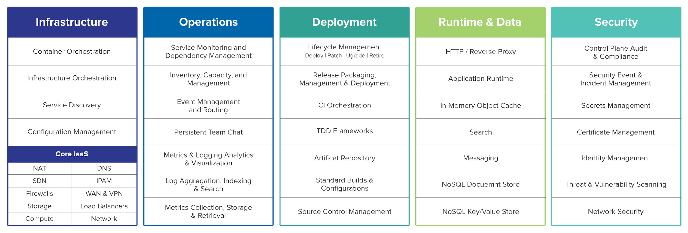
So, what actually makes up a cloud-native platform?
Notes:
What makes up a platform? What exactly is Cloud Foundry?

Slide 14


Pivotal Cloud Foundry Architecture
DYNAMIC ROUTE SERVICES / API MANAGEMENT
YOUR APPLICATIONS
PIVOTAL
APPLICATION
SERVICE
APP MICROSERVICES TECHNOLOGY
DATA MICROSERVICES TECHNOLOGY
Spring Boot
Steeltoe
Spring Cloud Services
Spring Cloud Data Flow
Cloud Cache
RabbitMQ
MySQL
MODERN
CLOUD NATIVE
PLATFORM
PLATFORM
Orgs, Spaces, Roles and Permissions
SERVICE
BROKER API
Elastic Runtime
Concourse
App
Autoscaler
PCF Metrics
CredHub
PIVOTAL
CLOUD FOUNDRY
BOSH
EMBEDDED OS
CONTAINER ORCHESTRATION
Windows
Linux
CLOUD ORCHESTRATION
MULTI CLOUD
Amazon
Web Services
Microsoft
Azure
Google
Cloud
Platform
Open Stack
VMWare

Slide 15

WE build the container
YOU build the container
Continuous
delivery
Application Code & Frameworks
Buildpacks | Spring Boot | Spring Cloud | Steeltoe
Github
Public Cloud Services
Pivotal Network
Open Service Broker API
Pivotal Application Service (PAS)
Pivotal Container Service (PKS)
Pivotal Services Marketplace
Customer Managed Services
Concourse
>cf push
>kubectl run
Pivotal and
Partner Products
v1
CVEs
Product Updates
Java | .NET | NodeJS
Elastic | Packaged Software | Spark
v2
“3Rs”
v3
...
Embedded OS
(Windows & Linux)
NSX-T
Repair
— CVEs
Repave
Rotate
— Credhub
Concourse
CPI (15 methods)
vSphere
Openstack
AWS
Google Cloud
Azure & Azure Stack
Notes:
Pivotal Cloud Foundry is Infrastructure agnostic multi-cloud platform. PCF can run on public cloud, whether its GCP, AWS or Azure. It can run on Openstack as well as on Prem on VMware. So the platform experience for the Operators is same across the cloud providers.
This is made possible by BOSH. It acts as a glue between Infrastructure and the Platform. BOSH interacts with Infrastructure using CPI (which is Cloud Provider Interface) thus provides abstraction from different cloud provider specific APIs.
BOSH is an open source tool for release engineering, deployment and lifecycle management of large scale distributed services.
From security point of view, BOSH enables to continuously update platforms to limit impact of threats. We apply the 3Rs of security. Repair CVEs, Repave bad nodes with last good state quickly, and constantly rotate credentials hence reducing the shelf life. You can use concourse pipelines to pull CVEs and Product Patches from Pivotal Network and Apply on the platform, without any down time. It has embedded OS for both Windows and Linux. It also integrates with NSX-T, to provide Software Defined Networking
On top of BOSH sits these 3 Platform Offerings and a 4th one on it’s way (I’ll touch on 4th one in a little bit).
First is PAS, which is PaaS offering. It is for running modern cloud native applications. Next is PKS which is CaaS offering, This is GKE compatible Kubernetes. We recommend to use PKS for running packaged software (like ES or Spark) or legacy apps which does not justify investment of modernization but you still would like to leverage the infrastructure elastic capabilities. And then we have Marketplace where we offer curated services which can be made available to your apps very easily - Database as a Service (like mysql), Data grip as a service (like Redis), Messaging as a Service (like Rabbit) as well as several partner services. This is achieved using Open Service Broker API and also enables platform to integrate seamlessly with Public Cloud or your custom managed services. You will see later in demo and workshop when we use Azure services on PCF.

Slide 16







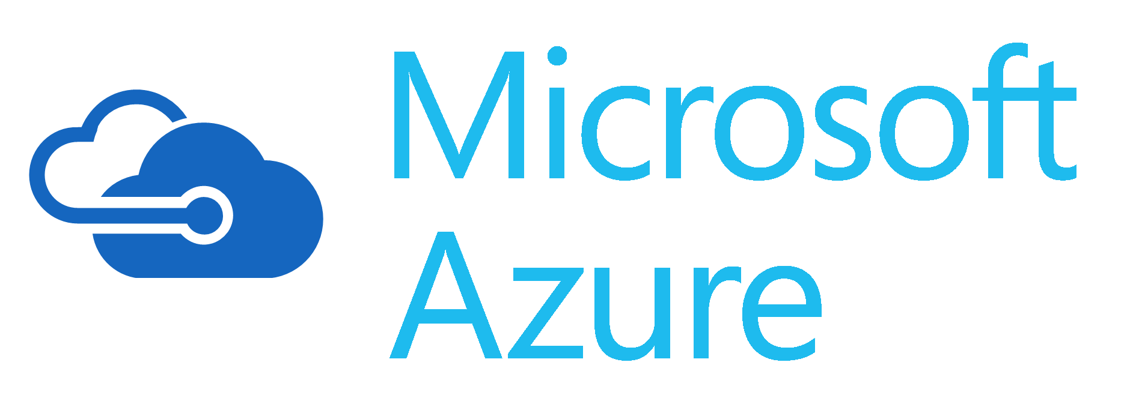
Platform Runtime - PAS
Services
HA Proxy LB
Service Broker
Dynamic Router
Service Nodes
App Manager UI
Cloud Controller
CC-Bridge
Service
Application Manager
UAA
Login Server
Diego
Service Broker
Auctioneer
BBS
Service Nodes
Windows
Cell
Rep
Linux
Cell
Rep
Service
CLI – Cmd Line
Executor
Executor
Terminal Window
+
=
Service Broker
Service Nodes
Messaging (NATS)
Service
Metrics Collection
App Log Aggregator
Notes:
The router routes incoming traffic to the appropriate component. It interrogates BBS (Bulletin Board System) to keep it’s routing table updated about where an app is running.
The UAA(User Account & Auth) and Login Server work together to provide identity management - static login, SSO, SAML, AD
The Cloud Controller (CC) directs the deployment of applications. To push an app to Cloud Foundry, you target the Cloud Controller
CC Bridge is the integrator between Diego and CC. It has components which helps stage an app deployment, monitors actual and desired no of instances, provides info about the app back to CC.
Diego is the Brain - the container management system.
When you push an app to Cloud Foundry
The Cloud Controller sends a request to the BBS API.
The BBS contacts the Auctioneer to create an Auction based on the desired resources for that App. The Rep accepts the Auction request.
The Rep creates a Garden container and executor executes the work encoded for the App. This work is encoded as a generic, platform-independent recipe of composable actions.
Diego sends real-time streaming logs to the Loggregator system and metrics to metrics system. This is hooked to PCF Metrics dashboard and can also be hooked to external aggregators like spunk via Firehose (which is a web socket endpoint). Diego also registers its running instances with the Gorouter (dynamic router) to route external web traffic to them.
Diego interacts using an open source messaging system called as NATS which is written in GO.

Slide 17
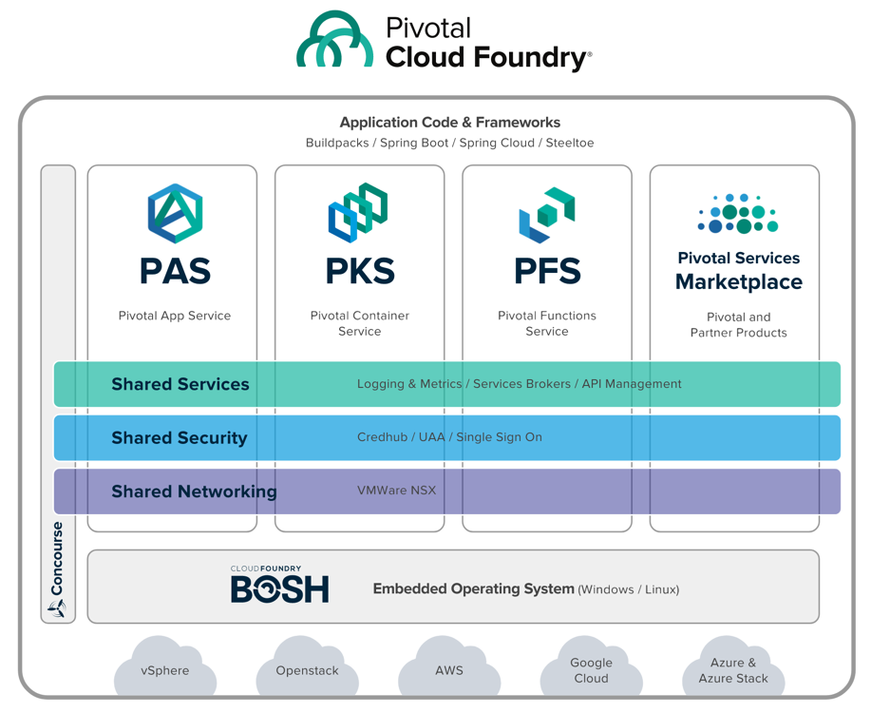
PCF 2.0
Any App
Every Cloud
One Platform
Notes:
As I was saying earlier, later this year we will be launching Pivotal Function Service is FaaS offering. It is based on an Open source project RIFF. RIFF IS FOR FUNCTIONS. It’s a polygon FaaS project. You can use Java, .Net, Pythin, Ruby etc

Slide 18
Deploying .NET applications? It doesn’t have to be terrible.
Traditional .NET deployment on VMs | Pivotal Cloud Foundry
Provision a VM Configure IP, DNS Configure firewall Windows updates, reboot… Install IIS Deploy application Configure app pool Configure SSL Configure load balancer | ~$ cf push
Notes:
Now scale your app. I’ll wait.
Go get another VM, figure out if it has what you need, duplicate your web server configs, update the LB, open up firewalls. Will you EVER scale down?
Still have to go package your code into an MSI, performing rolling upgrades, get code onto machines, run scripts, etc.

Slide 19

Code Complete & Tested
Find available hosts
Install & configure runtime
Install & configure middleware
Pull application source code
Retrieve dependent libraries
Create application package
Install, configure dependent service(s)
Deploy container to host(s)
Load environment variables
Configure load balancer
Configure firewalls
Update service monitoring tools
Configure log collector
45
seconds
later
~$ cf push
Application in Production

Slide 20
$ cf push my-app -p target/myapp.jar
or
$ cf push my-app --docker-image pivotal/my-image
Notes:
Cf push

Slide 21
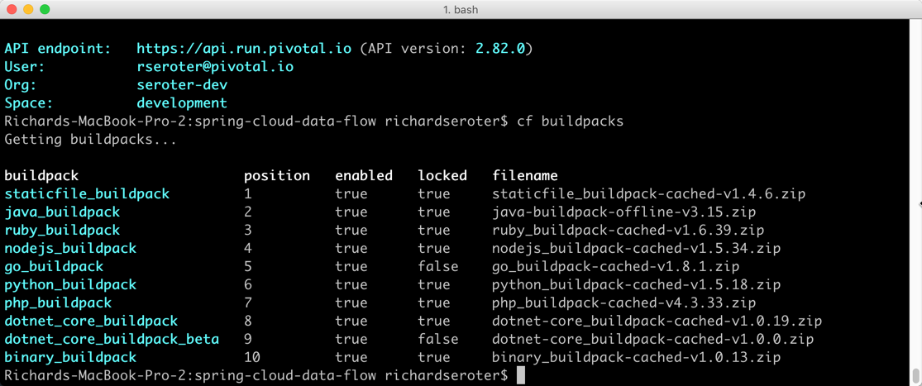
Buildpacks are language-aware
Notes:
Buildpacks provide framework and runtime support for apps. Buildpacks are language aware and typically examine your apps to determine what dependencies to download and how to configure the apps to communicate with bound services. When you push an app, Cloud Foundry automatically detects an appropriate buildpack for it. This buildpack is used to compile or prepare your app for launch.

Slide 22
Deploy source code that the platform containerizes for you
or
Deploy container images that you build yourself
Notes:
Here’s the difference between experience of Deploying code to PAS in comparison to deploying containers

Slide 23
Cloud Foundry
Deploy source code that the platform containerizes for you
or
Deploy container images that you build yourself
Developer
Cloud Controller triggers staging
Diego creates container
push source code
Diego lays down buildpack, source code
Diego mounts root file system
Diego builds and uploads droplet
Diego schedules containers onto Cells
Running app!
Notes:
How Cloud Foundry supports containers as a deployment unit (vs buildpacks)
When staging complete the output consists of metadata from the buildpack and a droplet, which is an archive of files that should be layered on top of the Root Filesystem. Cloud Controller asks Diego to launch instances of the application. Diego does this by scheduling containers on the Cells.
File System: The running application container contains the Root Filesystem and a copy of the application droplet.
Metadata: Cloud Controller provides Diego with metadata to launch the correct process within the Cloud Foundry Container Environment and to monitor the process’ health.

Slide 24
Cloud Foundry
Deploy source code that the platform containerizes for you
or
Deploy container images that you build yourself
Developer
Cloud Controller triggers staging
Diego spins up container to get metadata
Push Docker image
Developer
Generate and upload image
Diego schedules container onto Cells
Cloud Controller stores metadata
Developer
Create Dockerfile
Running app!
Developer
Identify base Docker image
Developer
Package source code
Notes:
How Cloud Foundry supports containers as a deployment unit (vs buildpacks)
After the metadata arrives, Cloud Controller asks Diego to launch instances of the application. Diego does this by scheduling containers on the Cells.
File System: Garden will download and cache the Docker image layers. It will then mount these layers into the Container file system. Some of the code that Garden uses for this process is shared code that is also used with Docker/OpenShift. Note that Garden will only download layers that have not been cached.
Metadata: Cloud Controller provides Diego with metadata to launch the correct process within the Cloud Foundry Container Environment and to monitor the process’ health.

Slide 25
Builds OCI-compatible containers
Generates both Linux and Windows containers
Option to SSH into running containers
Can rebuild containers to patch root file system
Performs log aggregation and correlation
Offers monitoring and auto scaling of containers
Introduces policy-driven container networking
Can attach persistent storage volumes
Intercept traffic via Route Services
Securely connect to outside services via Broker
Secure-by-default approach to containers
Cloud Foundry offers exceptional support for containers at runtime.
Notes:
How Cloud Foundry supports containers

Slide 26
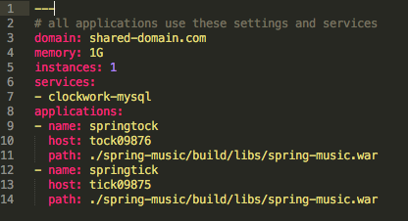
Define application metadata in a manifest file.
Application manifests tells cf push what to do with applications
What OS stack to run on: Windows or Linux
How many instances to create and how much memory to use.
Helps automate deployment, specially of multiple apps at once
Can list services to be bound to the application
YAML format – http://yaml.org
Notes:
As we talked that you can cf push your app and run and let PCF detect the app and run it with appropriate build pack and config. You can also provide a manifest file where you can instruct PCF to deploy the app as per your requirements.

Slide 27
Built for multi-tenancy
Push code or containers
Application manifests written in YAML
Injects environment variables
Aggregates app logs, correlates with metrics
Monitors app health, reacts
Scale manually or automatically
Built in data services, marketplace
Manages apps and underlying VMs
Natively runs on multiple IaaS platforms
Four layers of high availability built in
Access via GUI, REST API, CLI
Dev GUI = Applications Manager
Ops GUI = Operations Manager
Things about Pivotal Cloud Foundry you should know.
Notes:
Before we get into demo, here is the recap about PCF.
4 layers – app (container), process, VM, rack or data center

Slide 28
demo

Slide 29
break time

Slide 30

What’s Spring Been Up To?

Slide 31
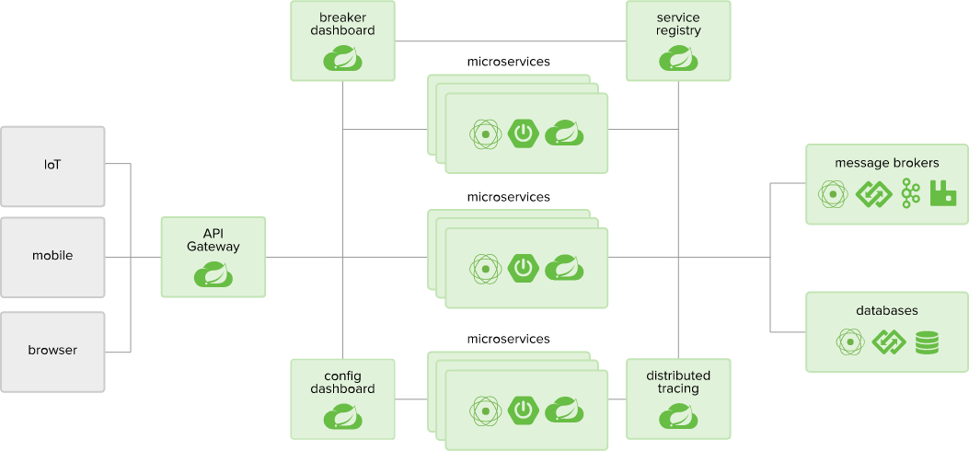
Spring Opportunities
Notes:
History of Spring. Replaces Java EE as a the “standard” Java Framework. Cover some high-level values of Spring.

Slide 32
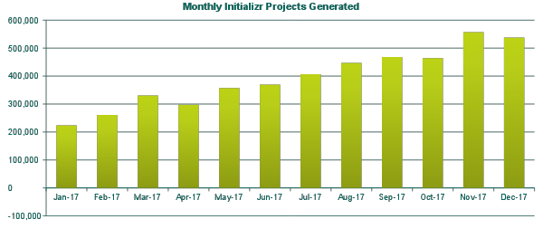
Spring Boot Popularity
Notes:
History of Spring. Replaces Java EE as a the “standard” Java Framework. Cover some high-level values of Spring.

Slide 33
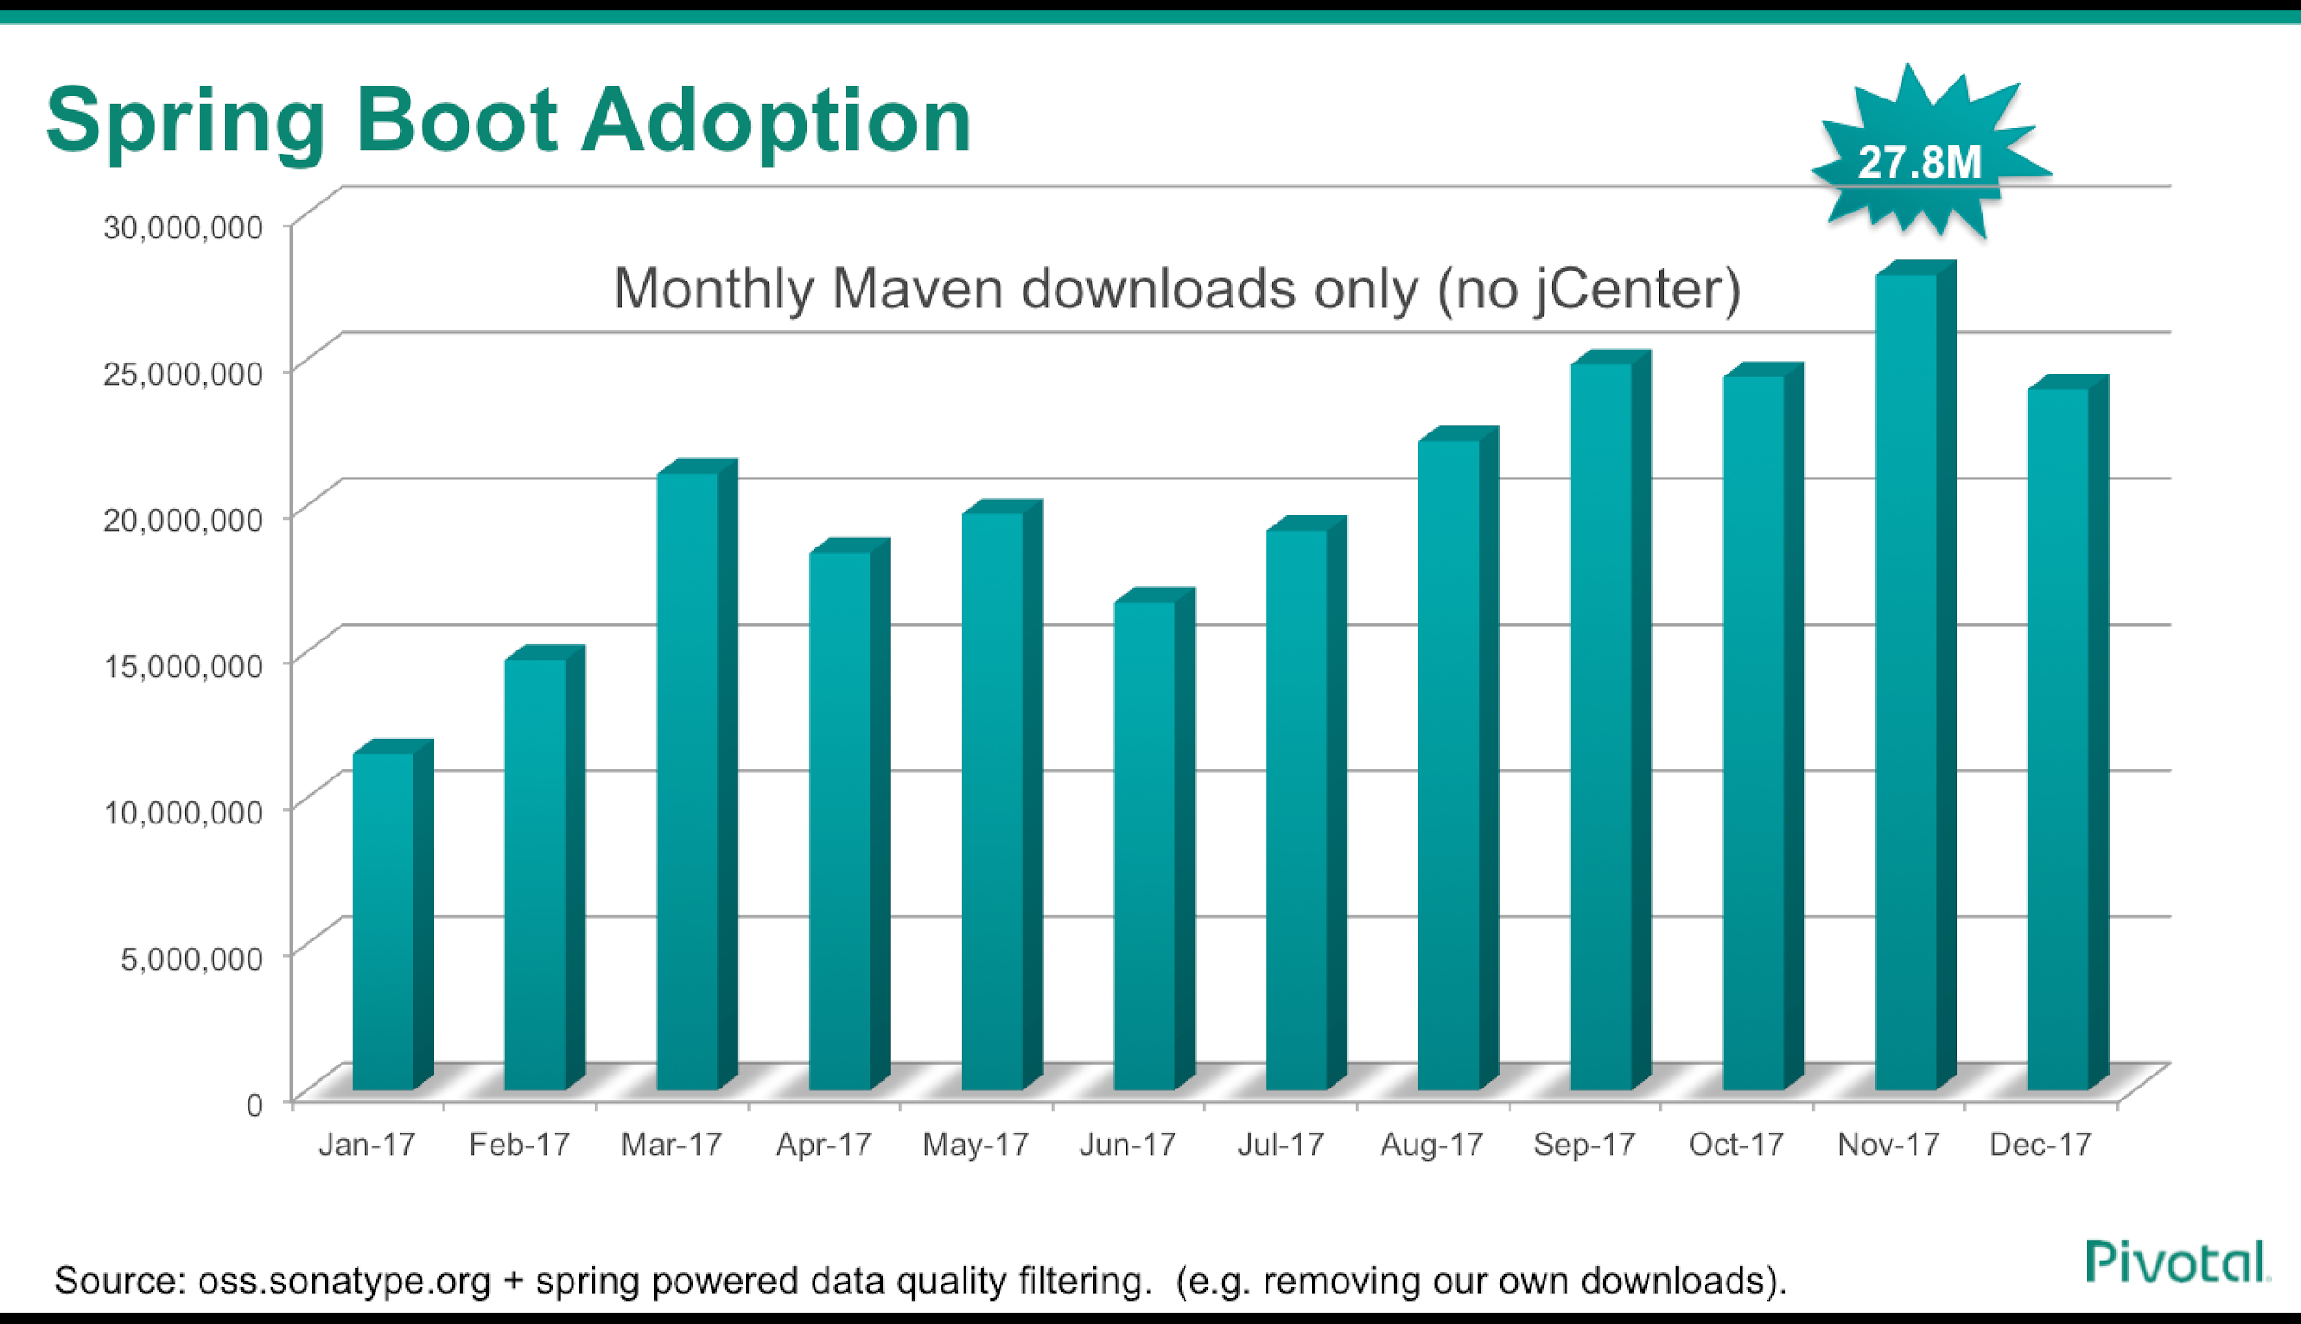

Slide 34

Spring Boot 101
Matt Gunter<mgunter@pivotal.io>
Senior Platform Architect | Pivotal, Tampa
Notes:
Welcome
Cora Iberkleid: 3.5 years at Pivotal - prior experience with application architecture, design and implementation, SOA.
Pivotal: Specialize in enabling Agile software development processes in organizations like yours and we build products and offer services to help this. We are the main contributor (in terms of commits) to Cloud Foundry and Concourse. We also employ the Spring, RabbitMQ, Gemfire and Greenplum teams amongst others.
We’ve been working with several teams in JPMC. We’re hoping to share our knowledge with you to help you get the most from the platform

Slide 35

Spring Packaging

Slide 36
What We Will Cover
The Case for Spring Boot
Problems to solve
Primary goals
How it’s different
Spring Boot Basics
Where to start?
Dependency Management
Configuration
Metrics
Actuator
Notes:
In this session we want to show the value of cna, establish a common vocabulary, and get you started

Slide 37
Challenges with Traditional Apps & Infrastructure
Shared Dependencies (App Server)
Tedious Configuration (“Classpath Hell”)
Intricate Coordination between Devs & Ops
Granularity of Scaling
“One Size Fits All” Operations
Large Teams, Large Releases, Long Lead times
Notes:
Environment “plumbing” related tasks are cumbersome and error-prone
Complex app server setup & management
Developers exposed to / limited by app server concerns
Ticket-heavy communication process between dev and ops
Managing shared libraries and configuration across environments is complex and brittle
Dependency management within an application (aka “Classpath Hell”)
Compiling the list of necessary dependencies is time-consuming
Resolving missing classpath problems is trial-and-error
The result is often brittle and requires fine-tuning to resolve version conflicts
Dependency management across environments (aka “Environment Drift”)
Shared libraries vary from environment to environment, creating conflicts and failures as applications are promoted downstream
Errors occur in one environment but not another, difficult to predict and troubleshoot
Manual/ticket-based process to request shared library configuration add delays
App Server setup & management is manual, cumbersome, and slow
Installing and configuring an app server cluster is non-trivial
Horizontal scaling is limited to the size of the cluster and to the speed with which the cluster is updated
Boilerplate code is time-consuming and non-standardized across apps and dev teams
For example, every application that accesses a relational database with JDBC needs to configure a JdbcTemplate and DataSource
Non-functional application requirements reduce productivity and lack standardization/flexibility
Dependency management within an application is time-consuming and brittle
Boilerplate code is time-consuming and non-standardized across apps and across development teams
Modularized code (SOA) often deployed as a monolith (single .ear) and/or tightly coupled with ESB
Ensuring production-grade features is non-trivial
Non-Boot Spring: mastering individual framework projects is challenging

Slide 38
Spring Boot Primary Goals
Production-grade Spring-powered apps with minimal fuss
Spring Boot
Make it fast & easy to get started with Spring development
Be opinionated, but get out of the way quickly when requirements diverge from the defaults
Provide a range of common and useful non-functional features (embedded servers, security, metrics, health checks, externalized configuration...)
Clean configuration - no code generation and no requirement for XML configuration
Reference: https://github.com/spring-projects/spring-boot
Notes:
From https://github.com/spring-projects/spring-boot
Spring Boot makes it easy to create Spring-powered, production-grade applications and services with absolute minimum fuss. It takes an opinionated view of the Spring platform so that new and existing users can quickly get to the bits they need.
You can use Spring Boot to create stand-alone Java applications that can be started using java -jar or more traditional WAR deployments. We also provide a command line tool that runs spring scripts.
Our primary goals are:
Provide a radically faster and widely accessible getting started experience for all Spring development
Be opinionated out of the box, but get out of the way quickly as requirements start to diverge from the defaults
Provide a range of non-functional features that are common to large classes of projects (e.g. embedded servers, security, metrics, health checks, externalized configuration)
Absolutely no code generation and no requirement for XML configuration

Slide 39
Cloud-Native Building Blocks
Spring Boot
Spring Cloud
Services
Cloud Foundry
A Standard Cloud-Native Approach to Java
Notes:
Set context
Today we will scratch the surface of Spring Boot
Next week, Spring Cloud Services for Java, then .NET…

Slide 40
Spring Boot
Classic JEE App
Self-Contained Runnable
Unit of Work
Decoupled from environment
Executable JAR
Microservice and devops friendly
“Just enough” embedded app server
Autonomous dependency management
Automated build (maven/gradle)
Easy to scale horizontally
Health and telemetry features for operationalization
Environment-Dependent
Collection of Logic
Requires env setup, config, and care
Non-executable WAR or EAR
Majority monolithic deployment
Large external app server
Classpath dependency, shared libraries
Build not always automated
Limited/complex scaling
Relies on external solutions for health/telemetry operationalization
Notes:
Rod Johnson:
The Spring framework was initially conceived to simplify Java EE complexity, but its core ideas have stood the test of time and proven a perfect basis for cloud applications. The original “Spring triangle” - Dependency Injection, Portable Service Abstractions, and AOP - are equally relevant today, when cleanly decoupling business logic from its environment is more important than ever.
Spring Boot is a new way of using Spring for the microservice era. It makes it easy to create new Spring services of any granularity, and to deploy them in a modern, containerized environment. Whereas a traditional “enterprise” Java application was a monolith running on an still larger application server, Spring Boot reverses things for simplicity and efficiency: the service rightly becomes the focal unit, and is deployed with just enough server to run it.

Slide 41

“
Spring Boot lets you pair-program
with the Spring team.
”
Josh Long, @starbuxman
Notes:
Spring Boot is an ooportunity for Spring to be opinionated

Slide 42
Recap
Spring Boot provides an executable scaffolding for cloud-native applications
Spring Boot has built-in opinions that offer the most common configurations and best practices, but allows you to easily diverge when necessary
Strives to maximize productivity for bootstrapping a new application, and for keeping individual components of a broader system independent and isolated from one another
Spring Boot includes non-functional features for production-grade code on Day 1

Slide 43
The Basics of Spring Boot

Slide 44
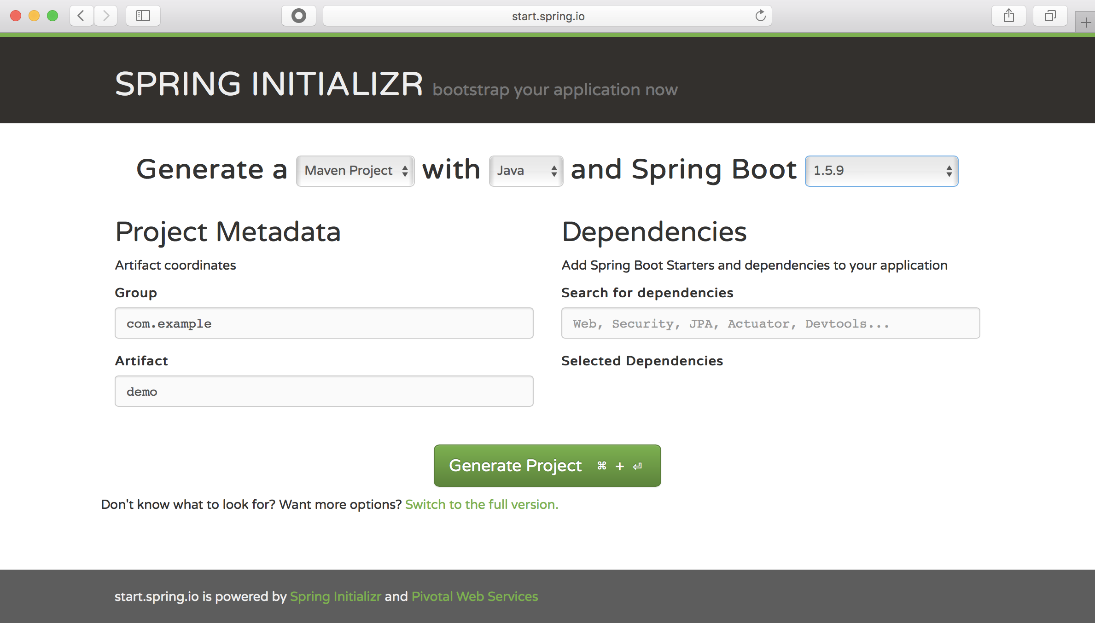
Getting Started: How Easy Is It?
Notes:
Select the latest milestone
Add Web
Hit Generate Project
Also exposed through CLI and IDEs

Slide 45
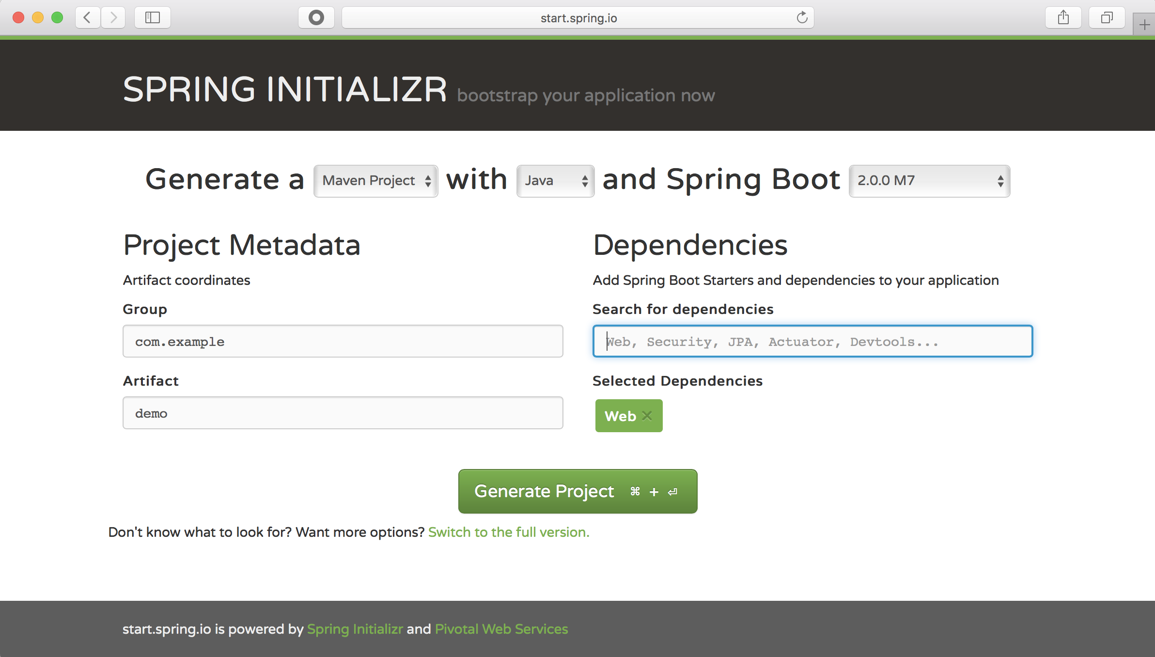
Getting Started: How Easy Is It?
select version
add dependencies
generate project (downloads demo.zip)
Notes:
Select the latest milestone
Add Web
Hit Generate Project
https://github.com/spring-io/initializr
Spring Initializr provides an extensible API to generate quickstart projects.
Spring Initializr can be used as follows:
1. With your browser (i.e. https://start.spring.io)
2. In your IDE if you are using STS, IntelliJ IDEA Ultimate or NetBeans (with this plugin)
3. On the command-line with the Spring Boot CLI or simply with cURL or HTTPie
Tip
You can "curl" an instance to get a usage page with examples (try curl start.spring.io)

Slide 46
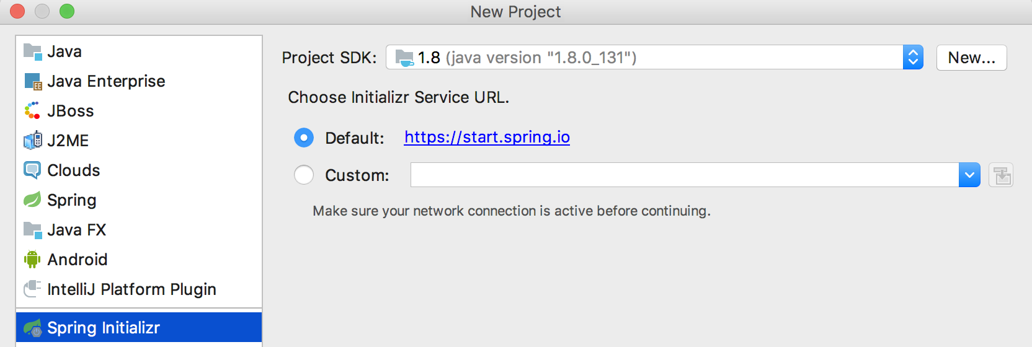
Spring Initializr Alternative Clients
IDEs (STS/IntelliJ/NetBeans) and Command Line (Spring Boot CLI/curl/HTTPie)
Command-line options:
$ spring init --dependencies=web demo.zip
$ curl start.spring.io/starter.zip -d dependencies=web -o demo.zip
Notes:
$ curl https://start.spring.io/starter.zip -d dependencies=web -o demo2.zip

Slide 47
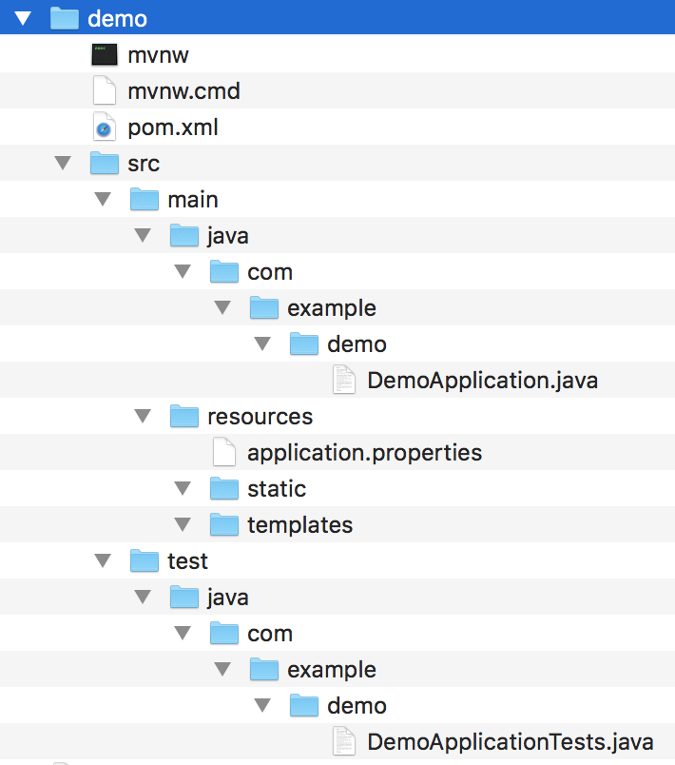
Skeleton Application
Project Structure
Pom File
Maven Wrapper
Main & Test Java Classes
Application Properties File (initially empty)
Ready to run!
Notes:
Ready to use skeleton application
Includes configuration and a few opinions, which we’ll see shortly

Slide 48

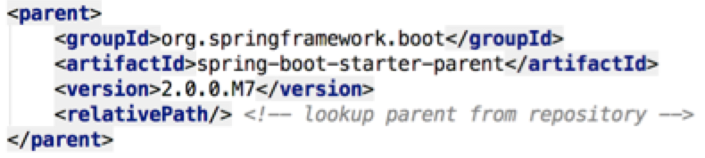
Dependency Management
pom.xml
Spring Boot Starter Parent defines default properties (e.g. Java version), plugin config, and dependency lists & versions
Notes:
Parent Poms allow you to manage the following things for multiple child projects and modules:
Configuration - Java Version and Other Properties
Depedency Management - Version of dependencies
Default Plugin Configuration
https://github.com/spring-projects/spring-boot/blob/master/spring-boot-project/spring-boot-dependencies/pom.xml

Slide 49
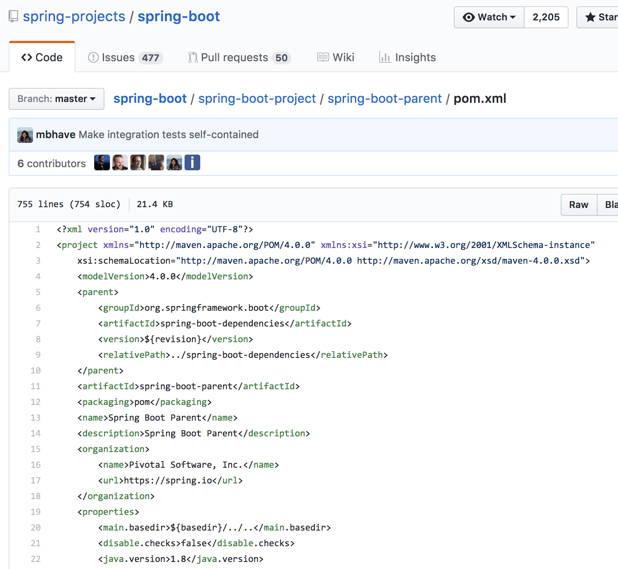
Dependency Management
pom.xml
Declares a “grandparent,”, ../spring-boot-dependencies/pom.xml, which specifies the dependency versions
Notes:
Parent Poms allow you to manage the following things for multiple child projects and modules:
Configuration - Java Version and Other Properties
Depedency Management - Version of dependencies
Default Plugin Configuration
https://github.com/spring-projects/spring-boot/blob/master/spring-boot-project/spring-boot-dependencies/pom.xml

Slide 50
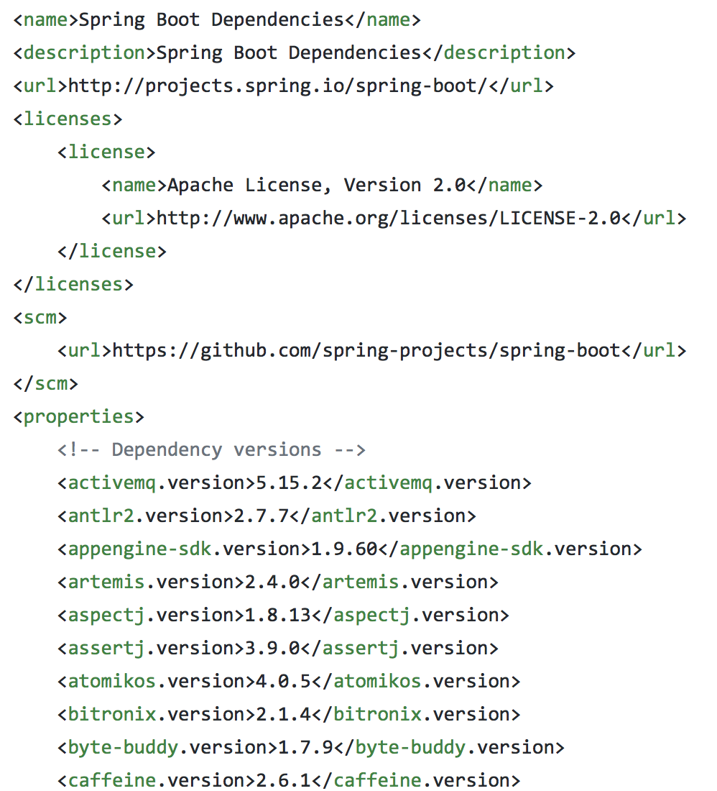
Dependency Management
pom.xml
Spring Boot Dependencies contains the versions of included dependencies
This information is published to Maven repo
Notes:
Parent Poms allow you to manage the following things for multiple child projects and modules:
Configuration - Java Version and Other Properties
Depedency Management - Version of dependencies
Default Plugin Configuration
https://github.com/spring-projects/spring-boot/blob/master/spring-boot-project/spring-boot-dependencies/pom.xml

Slide 51
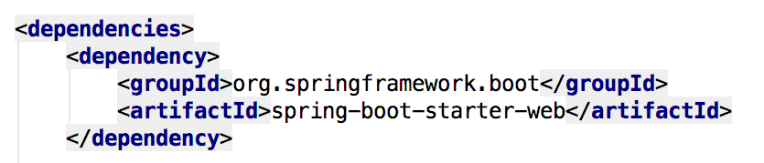
Feature-Specific Starters
pom.xml
Less dependencies - and no versions - to manage!
Notes:
We have a starter app with web and tests
Not many dependencies or any versions….
Includes pom
With parent
That brings dependency management
(“spring-boot-starter-parent pom brings dependency management”)
Spring Boot includes dependency management
Boot applications don’t usually list a lot of dependencies because they are managed
Give you the assurance that the versions being used are “blessed by the Spring Boot team” - Boot team is running their integration tests with these version sets and is careful not to break public APIs.

Slide 52
Feature-Specific Starters
pom.xml
Less dependencies - and no versions - to manage!
spring-boot-starter-web
spring-web
spring-webmvc
hibernate-validator
spring-boot-starter-json
spring-boot-starter-tomcat
spring-boot-starter
Notes:
https://mvnrepository.com/
We have a starter app with web and tests
Not many dependencies or any versions….
Includes pom
With parent
That brings dependency management
(“spring-boot-starter-parent pom brings dependency management”)
Spring Boot includes dependency management
Boot applications don’t usually list a lot of dependencies because they are managed
Give you the assurance that the versions being used are “blessed by the Spring Boot team” - Boot team is running their integration tests with these version sets and is careful not to break public APIs.
Virtual packages deployed to Maven central
Pull in other dependencies and default configuration

Slide 53
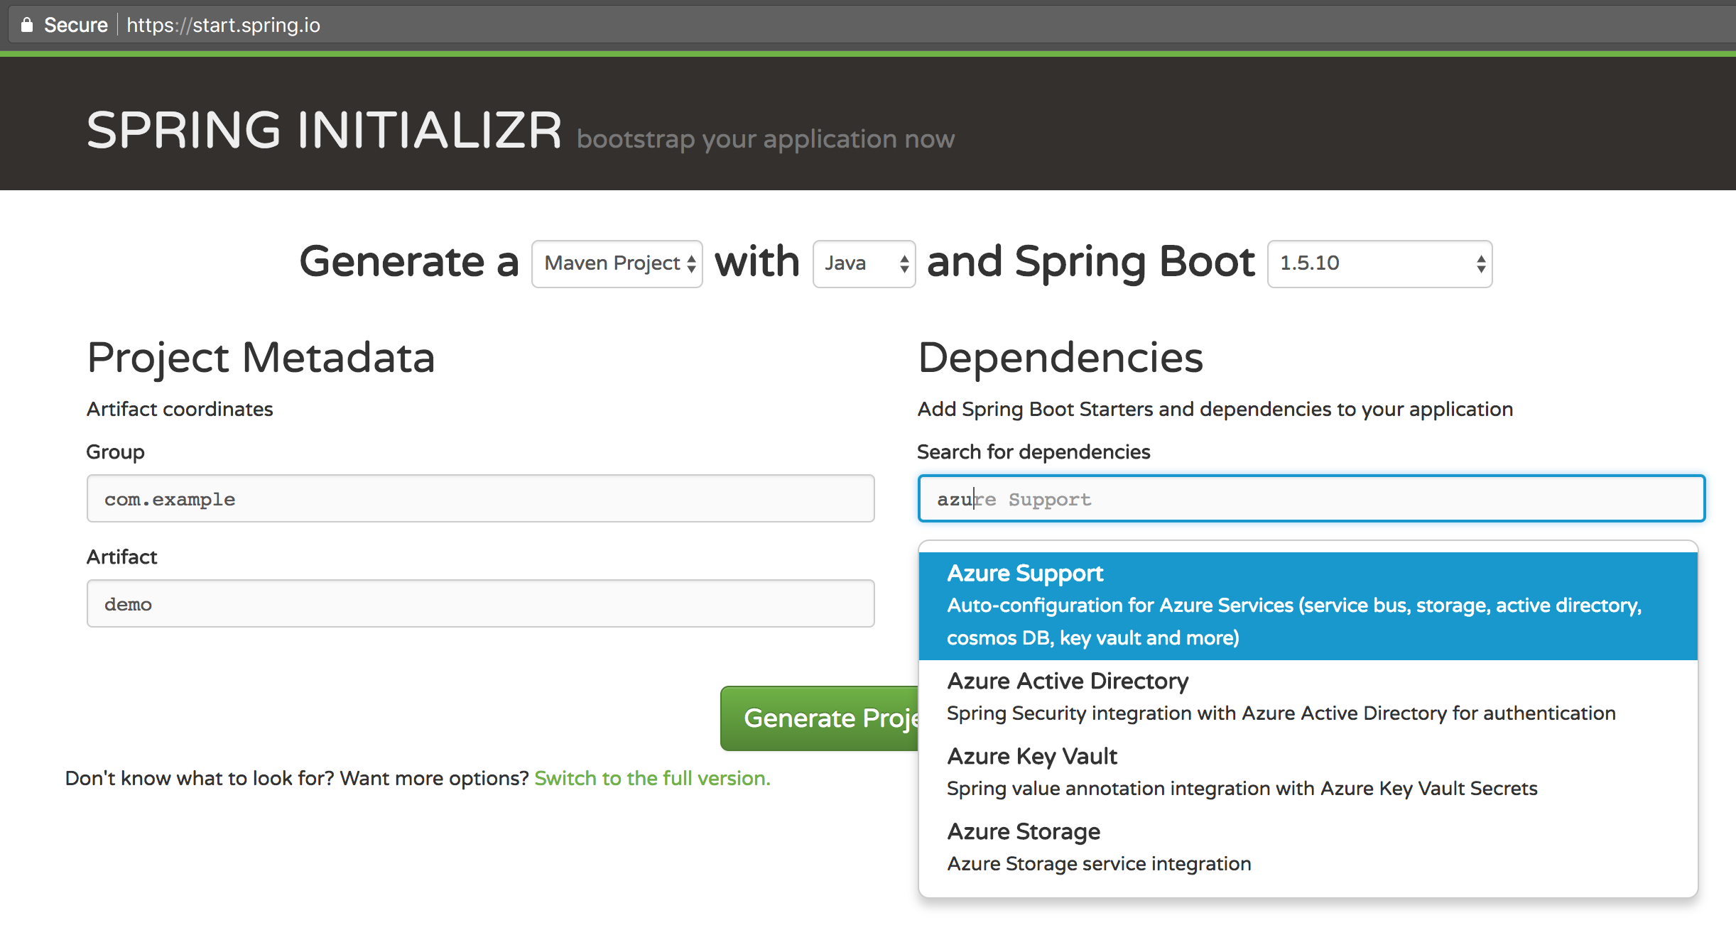
Spring Boot Starters for Azure
Notes:
Explain all the great work done by MSFT in collaboration with our Spring team to have their Starters published on start.spring.io Very importantly, explain here that these Starters will speed up how you build and deploy Spring apps to PCF. Mention that the next Lab will cover Azure Spring Boot Starters + Azure Service Broker

Slide 54
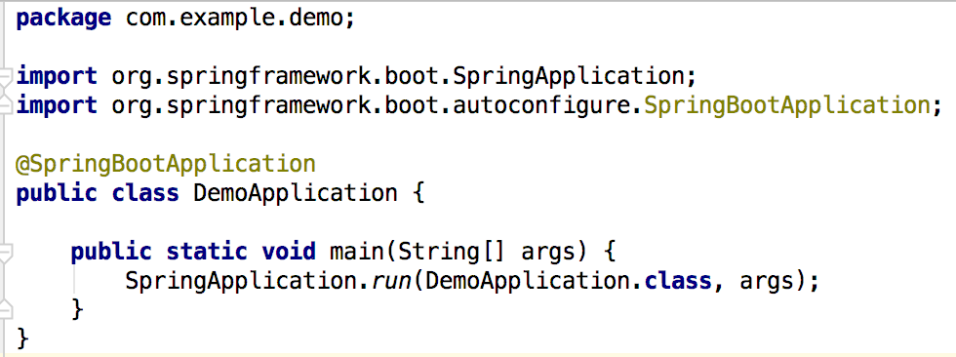
Skeleton Code - Ready to Run
Java
code

Slide 55
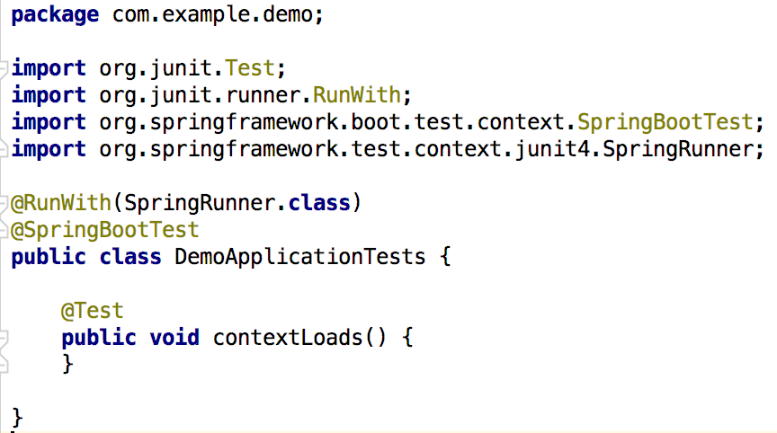
Skeleton Code - Ready to Test
Java
code

Slide 56
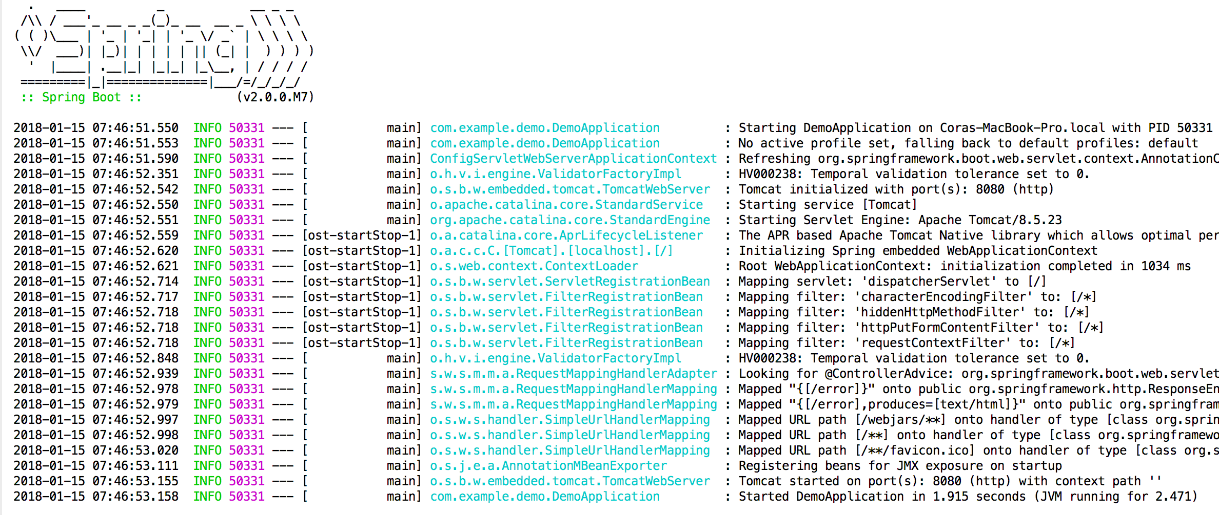
Run it!
We asked for “Starter Web”
Spring Boot recommends MVC and embedded Tomcat.
Tomcat started on port 8080
Notes:
Essence of Spring Boot:
You begin to express an opinion and Spring Boot tries to express one as well
E.g.
We’ve said here this is a web application
That will bring several dependencies, including Spring MVC and Tomcat as a default server
So we can see starting the app starts a Tomcat server on port 8080

Slide 57
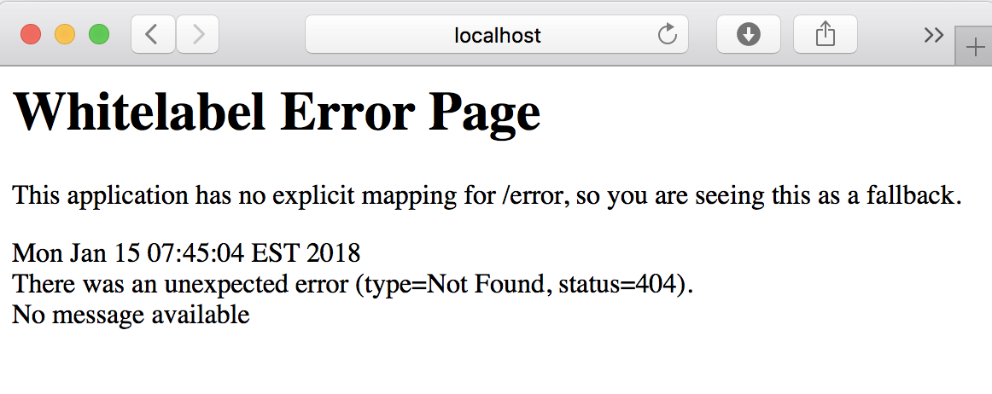
Default Error Handling
Notes:
If you go there you see a whitelabel error page (404)

Slide 58
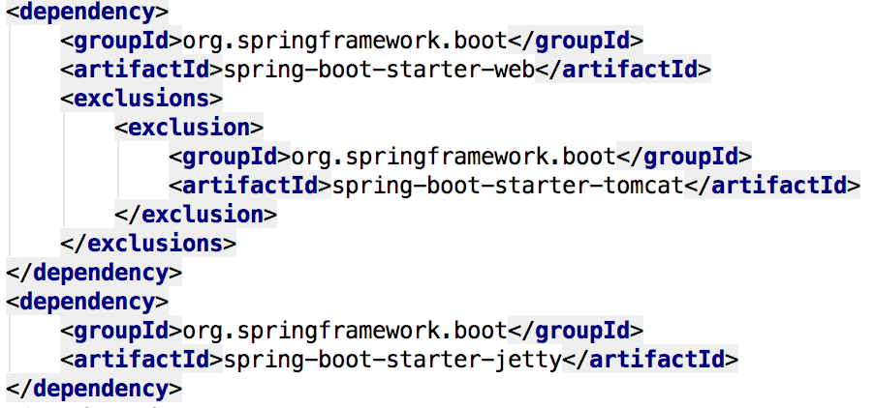
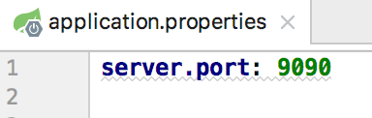
Strong Opinions Weakly Held
Override defaults by specifying your desired configuration

Slide 59
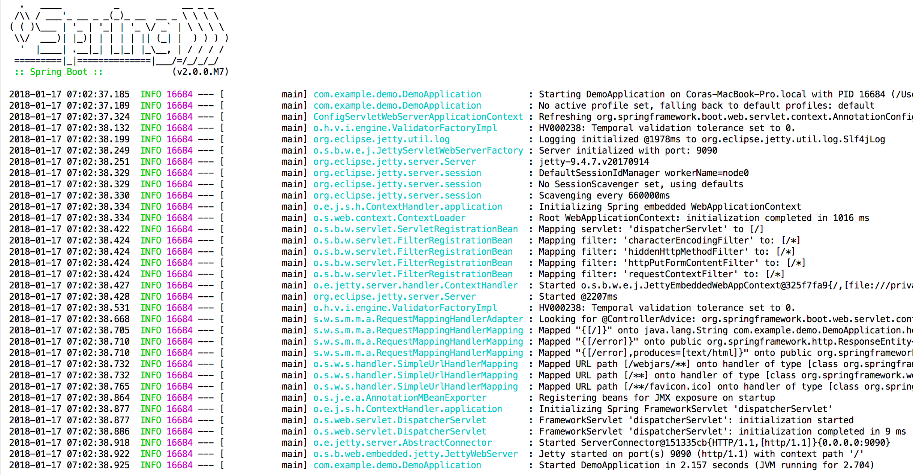
Run it!
Jetty started on port 9090
Notes:
Essence of Spring Boot:
You begin to express an opinion and Spring Boot tries to express one as well
E.g.
We’ve said here this is a web application
That will bring several dependencies, including Spring MVC and Tomcat as a default server
So we can see starting the app starts a Tomcat server on port 8080

Slide 60
Spring Boot Hello World Web App
package com.example.demo;
import org.springframework.boot.SpringApplication;
import org.springframework.boot.autoconfigure.SpringBootApplication;
import org.springframework.web.bind.annotation.RequestMapping;
import org.springframework.web.bind.annotation.RestController;
@RestController
@SpringBootApplication
public class DemoApplication {
@RequestMapping("/")
String home() {
return "Hello World!";
}
public static void main(String[] args) {
SpringApplication.run(DemoApplication.class, args);
}
}

Slide 61
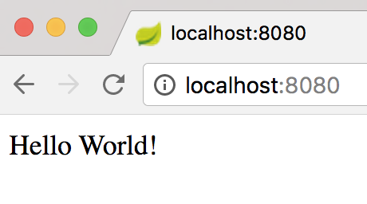
Spring Boot Hello World Web App
package com.example.demo;
import org.springframework.boot.SpringApplication;
import org.springframework.boot.autoconfigure.SpringBootApplication;
import org.springframework.web.bind.annotation.RequestMapping;
import org.springframework.web.bind.annotation.RestController;
@RestController
@SpringBootApplication
public class DemoApplication {
@RequestMapping("/")
String home() {
return "Hello World!";
}
public static void main(String[] args) {
SpringApplication.run(DemoApplication.class, args);
}
}
Notes:
What happended? How is this code getting activated?

Slide 62
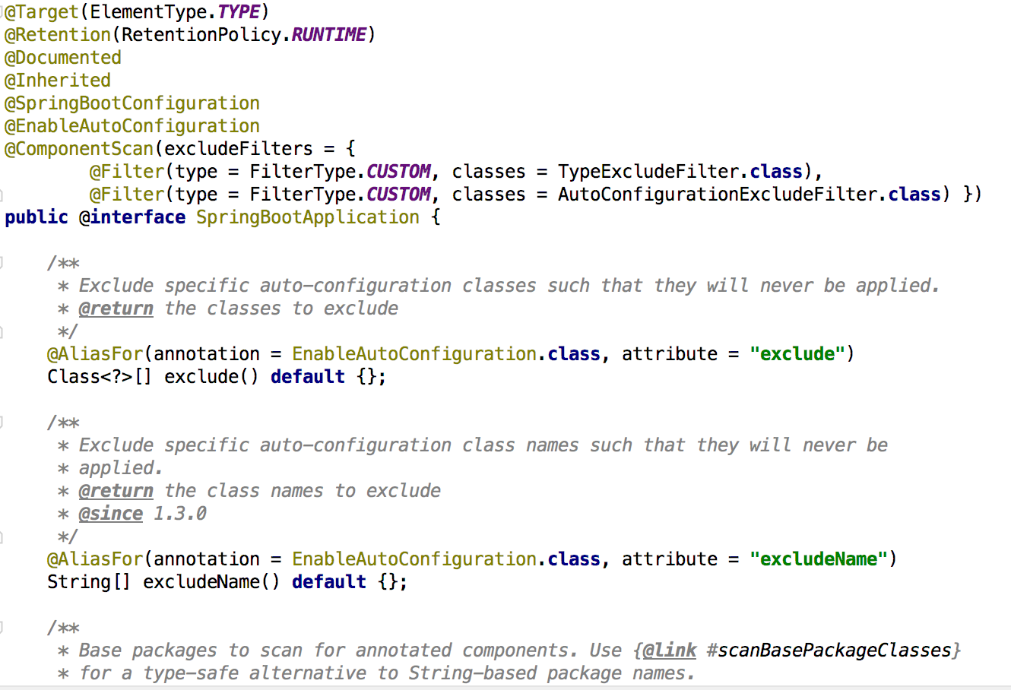
What Happened?
Demystifying @SpringBootApplication
Convenience annotation equivalent to:
@SpringBootConfiguration
@ComponentScan
@EnableAutoConfiguration
Notes:
Indicates a {@link Configuration configuration} class that declares one or more
* {@link Bean @Bean} methods and also triggers {@link EnableAutoConfiguration
* auto-configuration} and {@link ComponentScan component scanning}. This is a convenience
* annotation that is equivalent to declaring {@code @Configuration},
* {@code @EnableAutoConfiguration} and {@code @ComponentScan}.
*

Slide 63
Remember
Easy to get started
Starters dramatically simplify dependency management
SpringBoot packaging as self-contained, executable (“fat”) jar
Opinionated - like pairing with the Spring team!
Configurable - easy to diverge from opinionated defaults
Demystified “magic” of conditional auto-configuration

Slide 64
Actuator
Metrics
Health
Data
Info
Record
Gauges
Counters
Compose
Disk Space
Data Source Connection
JMS
Rabbit
Redis
...
Liquibase
Flyway
Configuration
Build Info
Git Version
Build Date
Notes:
actuator
Provides a hypermedia-based “discovery page” for the other endpoints. Requires Spring HATEOAS to be on the classpath.
Secure
auditevents
Exposes audit events information for the current application.
Secure
autoconfig
Displays an auto-configuration report showing all auto-configuration candidates and the reason why they ‘were’ or ‘were not’ applied.
Secure
beans
Displays a complete list of all the Spring beans in your application.
Secure
configprops
Displays a collated list of all @ConfigurationProperties.
Secure
dump
Performs a thread dump.
Secure
env
Exposes properties from Spring’s ConfigurableEnvironment.
Secure
flyway
Shows any Flyway database migrations that have been applied.
Secure
health
Shows application health information (when the application is secure, a simple ‘status’ when accessed over an unauthenticated connection or full message details when authenticated).
Not Secure
info
Displays arbitrary application info.
Not Secure
loggers
Shows and modifies the configuration of loggers in the application.
Secure
liquibase
Shows any Liquibase database migrations that have been applied.
Secure
metrics
Shows ‘metrics’ information for the current application.
Secure
mappings
Displays a collated list of all @RequestMapping paths.
Secure
shutdown
Allows the application to be gracefully shutdown (not enabled by default).
Secure
trace
Displays trace information (by default the last 100 HTTP requests).
Secure

Slide 65
Actuator Information- Types
Configuration
/beans
/autoconfig
/env
/configprops
/controller
Metrics
/metrics
/trace
/dump
Miscellaneous
/shutdown
/info
Notes:
We can take a moment to add DevTools - very useful for the whole dev lifecycle
When devtools is running, it detects change when you recompile your application and automatically refreshes it. This works for not only resources but code as well. It also provides a LiveReload server so that it can automatically trigger a browser refresh whenever things change.
Offers production-ready features such as monitoring and metrics to improve operator efficiency

Slide 66
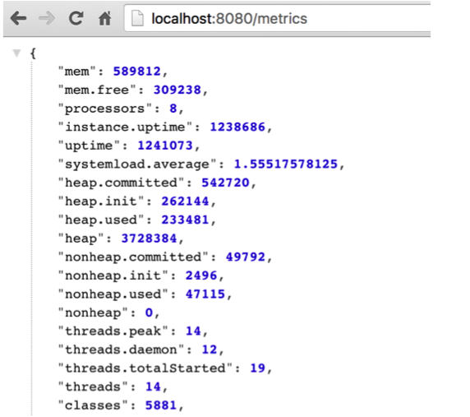
/metrics
Report application metrics
Memory usage
HTTP Request Counters
And more...

Slide 67
Auto-Configured Health Indicators
DiskSpaceHealthIndicator | Checks for low disk space
DataSourceHealthIndicator | Validates DataSource connection
ElasticsearchHealthIndicator | Checks if Elasticsearch is up
JmsHealthIndicator | Checks if a JMS broker is up
MailHealthIndicator | Checks if a mail server is up
MongoHealthIndicator | Checks if MongoDB is up
RabbitHealthIndicator | Checks if RabbitMQ server is up
RedisHealthIndicator | Checks if Redis server is up
SolrHealthIndicator | Checks if Solr server is up
CassandraHealthIndicator | Checks if Cassandra DB is up
Notes:
@SpringBootApplication is a convenience annotation that adds all of the following:
@Configuration tags the class as a source of bean definitions for the application context.
@EnableAutoConfiguration tells Spring Boot to start adding beans based on classpath settings, other beans, and various property settings.
Normally you would add @EnableWebMvc for a Spring MVC app, but Spring Boot adds it automatically when it sees spring-webmvc on the classpath. This flags the application as a web application and activates key behaviors such as setting up a DispatcherServlet.
@ComponentScan tells Spring to look for other components, configurations, and services in the hello package, allowing it to find the controllers.

Slide 68
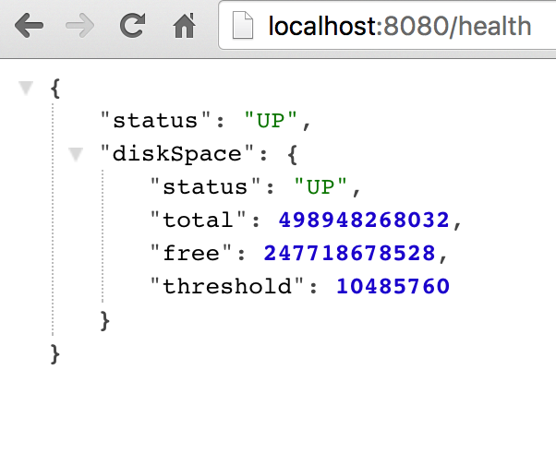
/health
Reports health metrics for the App
Each check returns a Health object
status
UP
DOWN
UNKNOWN
OUT_OF_SERVICE
Custom….

Slide 69
Custom Health Indicator
import org.springframework.boot.actuate.health.Health;
import org.springframework.boot.actuate.health.HealthIndicator;
import org.springframework.stereotype.Component;
@Component
public class MyHealthIndicator implements HealthIndicator {
@Override
public Health health() {
int errorCode = check(); // perform some specific health check
if (errorCode != 0) {
return Health.down().withDetail("Error Code", errorCode).build();
}
return Health.up().build();
}
}
Notes:
To provide custom health information you can register Spring beans that implement the HealthIndicator interface. You need to provide an implementation of the health() method and return a Health response. The Health response should include a status and can optionally include additional details to be displayed.

Slide 70
Profiles
Why?
Flexibility
Runtime
Feature Control
server:
port: 9000
---
spring:
profiles: development
server:
port: 9001
---
spring:
profiles: production
server:
port: 0

Slide 71
Questions?
SESSION FOUR
Notes:
Agenda:
Monolith
Domain Driven Design
Cloud Native

Slide 72
Break

Slide 73
Spring Cloud Services
SESSION FIVE

Slide 74
Supported Services
Spring Cloud Config Server
Eureka Service Registry
Hystrix Circuit Breaker Dashboard (with Turbine Metrics Aggregation)

Slide 75




Spring Cloud ….leverages
Client
Ribbon
Archaius
Hystrix
Feign
Zuul
Server
Eureka
Turbine
Notes:
Diving into Spring Cloud Netflix, for example, we see here some of the Netflix OSS projects for which Spring Cloud provides integrations.
Ribbon, the Netflix client-side load balancer, and Eureka, the Netflix discovery server, can be used together as we saw earlier where the client side load balancer loads routing information from the discovery server and applies its own load balancing rules.
Netflix Hystrix is an implementation of a circuit breaker. With Spring annotations, we can use AOP to add fallback commands to methods. We can also automatically report failures and metrics ass streams, in accordance with 12-factor app principles, and Netflix Turbine can collect these streams and provide an aggregated visualization into the state of all circuit breakers in the system.
------------------------------
Auxiliary notes:
Ribbon: A client load balancer. Ribbon loads routing info from Eureka. It has several implementations of load balancing rules. Ribbon is used internally by Feign
Feign: A declarative REST client. Allows annotation of interface to be mapped to endpoints. When combined with Ribbon it adds load balancing capabilities to the client interface
Hystrix: Circuit breaker pattern implementation. Via spring annotations add commands to methods using AOP. Protects clients from failures and reports metrics via a stream of HTTP events
Zuul: A set of HTTP filters do add routing, security. On spring it's used to create a CORS filter for UI apps to be able to access external services
Archaius: Dynamic configuration management. Used with Spring’s config server to allow dynamic properties loading
Eureka: Discovery server
Turbine: Event aggregation engine. It can combine several streams (hystrix) into one combined view, that can be view later on a dashboard

Slide 76
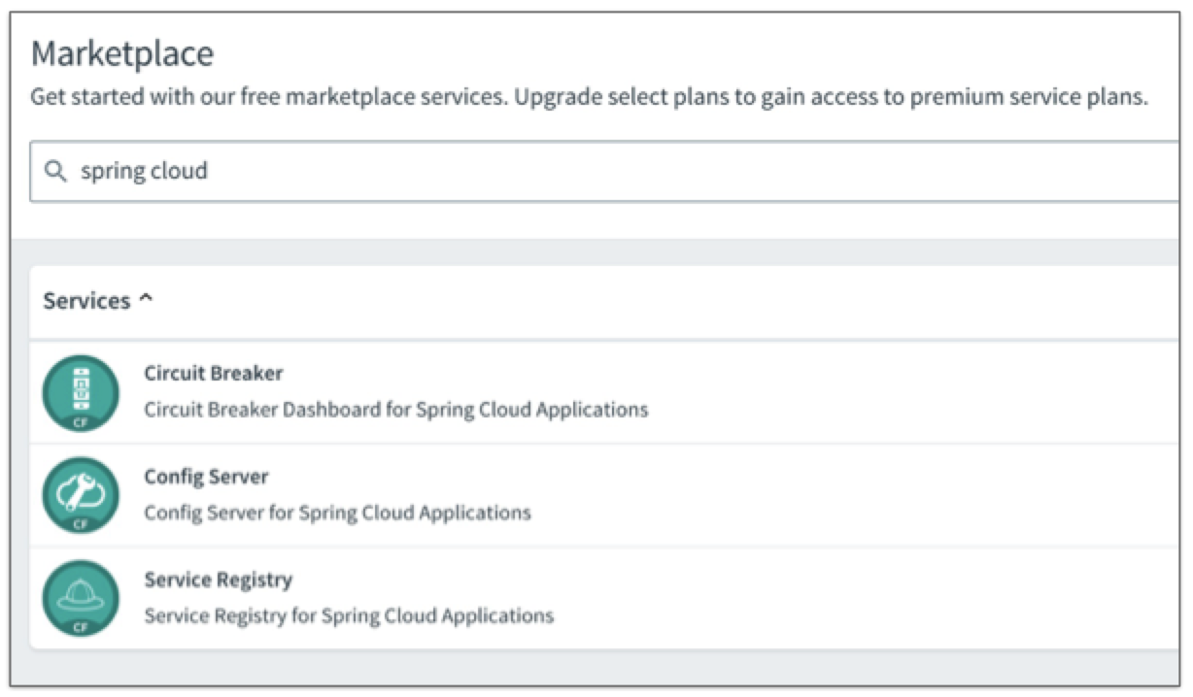
Cloud Foundry Marketplace
Filter for Spring Cloud...

Slide 77
Why Microservices?
Each team works independently
Developer velocity is high
Deployments become non-events
More flexibility vis-a-vis choice of programming language, persistence technology
Simpler code to maintain

Slide 78
What’s Harder with Microservices?
Must maintain and deploy more codebases, more applications. Without automation, this can become a real problem
Service calls are no longer a method call away
Application becomes a distributed system: distributed computing is hard

Slide 79
What’s Harder with Microservices?
Must maintain and deploy more codebases, more applications. Without automation, this can become a real problem
Service calls are no longer a method call away
Application becomes a distributed system: distributed computing is hard
This will be our focus for today

Slide 80
Challenges of Distributed Systems
Configuration management
Registration and discovery
Routing and load balancing
Fault tolerance and isolation
Aggregation and transformation
Monitoring and distributed tracing
Process management
These will be our focus for today

Slide 81
Cloud-Native Building Blocks
Spring Boot
Spring Cloud
Services
Cloud Foundry
A Standard Cloud-Native Approach to Java
Notes:
Set context
Today we will scratch the surface of Spring Boot
Next week, Spring Cloud Services for Java, then .NET…

Slide 82
Spring Cloud Services
Production-grade Spring Boot-powered app services with minimal fuss
Spring Cloud
Services
Spring Cloud + Netflix OSS + Gaia Marketplace
Select group of Spring Cloud projects provided as managed services in Gaia
Spring Cloud Config for externalizing configuration
Spring Cloud Netflix and Eureka for locating services
Spring Cloud Netflix, Hystrix, and Turbine for protecting your services against cascading effects of latency and failure
Notes:
From https://github.com/spring-projects/spring-boot
Spring Boot makes it easy to create Spring-powered, production-grade applications and services with absolute minimum fuss. It takes an opinionated view of the Spring platform so that new and existing users can quickly get to the bits they need.
You can use Spring Boot to create stand-alone Java applications that can be started using java -jar or more traditional WAR deployments. We also provide a command line tool that runs spring scripts.
Our primary goals are:
Provide a radically faster and widely accessible getting started experience for all Spring development
Be opinionated out of the box, but get out of the way quickly as requirements start to diverge from the defaults
Provide a range of non-functional features that are common to large classes of projects (e.g. embedded servers, security, metrics, health checks, externalized configuration)
Absolutely no code generation and no requirement for XML configuration

Slide 83
Circuit Breakers

Slide 84
Hystrix
“Hystrix is a library that helps you control the interactions between these distributed services by adding latency tolerance and fault tolerance logic.
Hystrix does this by isolating points of access between the services, stopping cascading failures across them, and providing fallback options, all of which improve your system’s overall resiliency.”

Slide 85
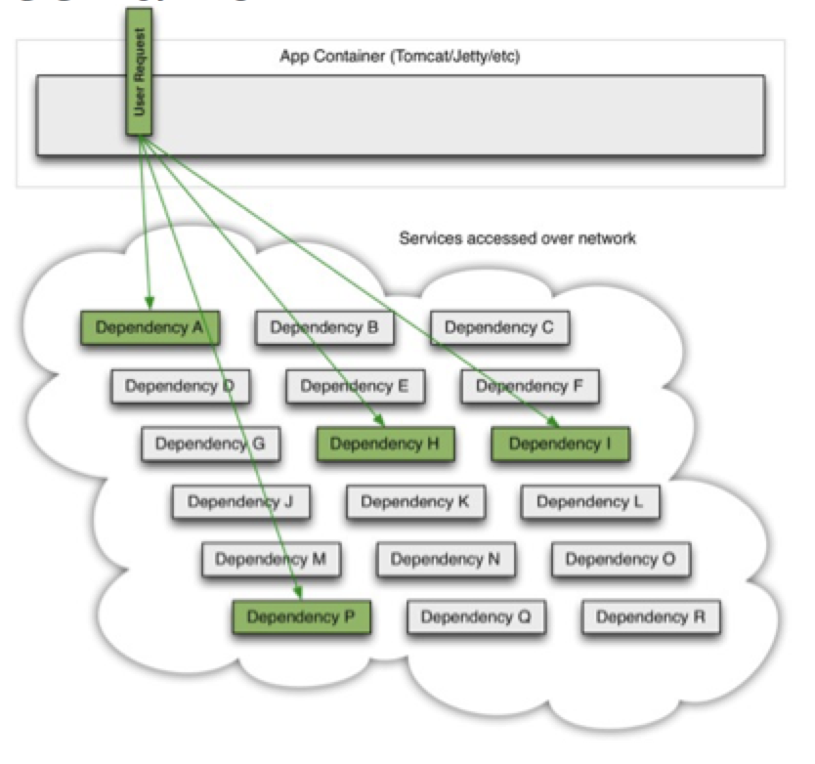
Service Dependency Scenario
A typical application depending on a number of backing services
All services are up and behaving normally
Circuit is Closed

Slide 86
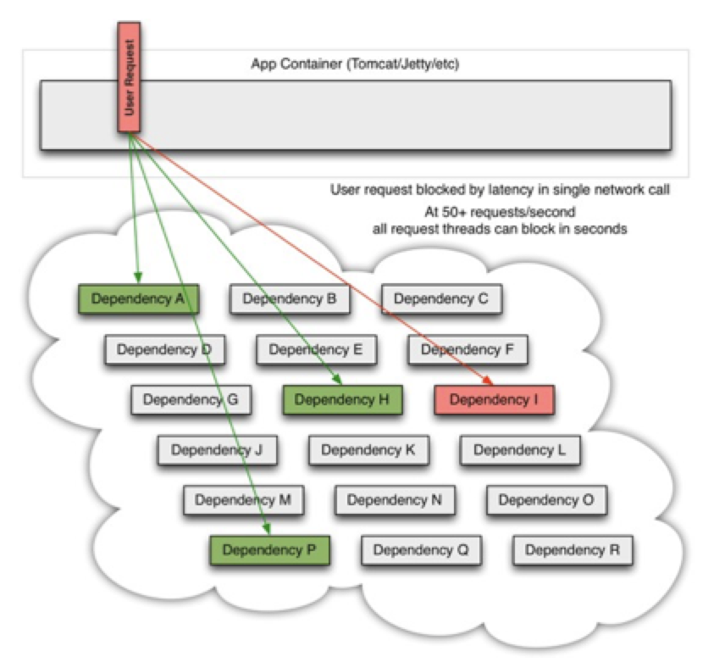
Failing Dependency
A dependency begins misbehaving
Response latency increases, tying up thread in calling application

Slide 87
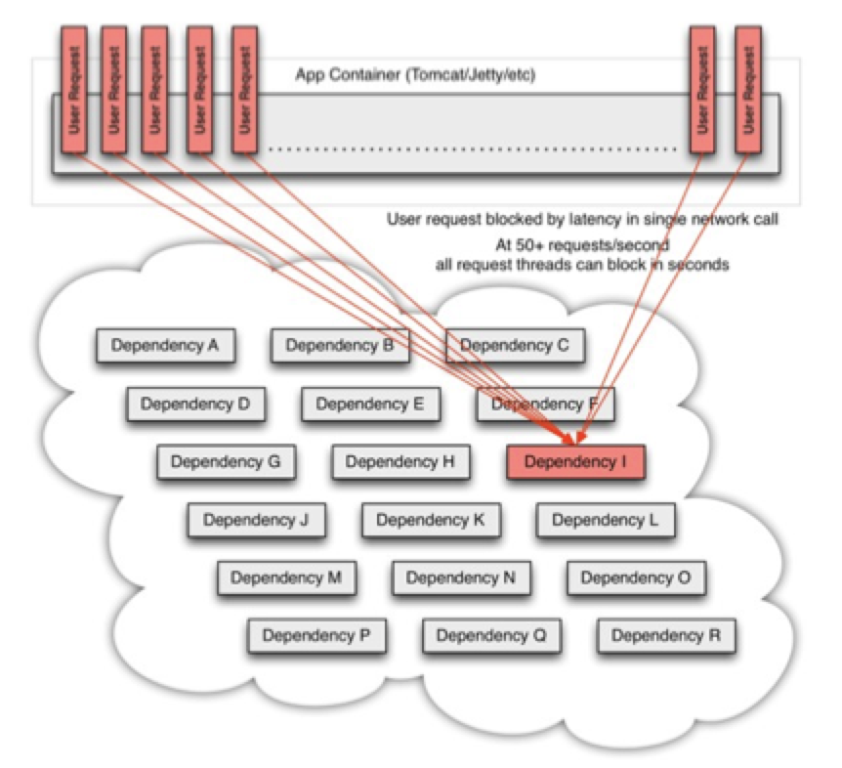
Failure Cascades to Caller
Calling application’s thread pool is exhausted waiting on misbehaving dependency
Failure cascades to caller

Slide 88
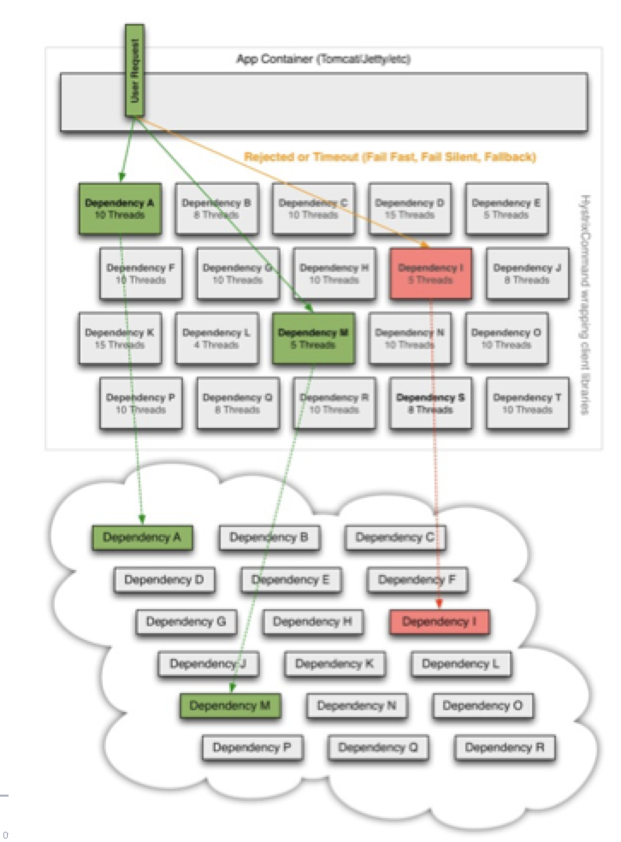
Application Protected with Hystrix
Application is isolated from a misbehaving backing service
When backing service health is restored, calling application will automatically reconfigure itself to call it once more

Slide 89
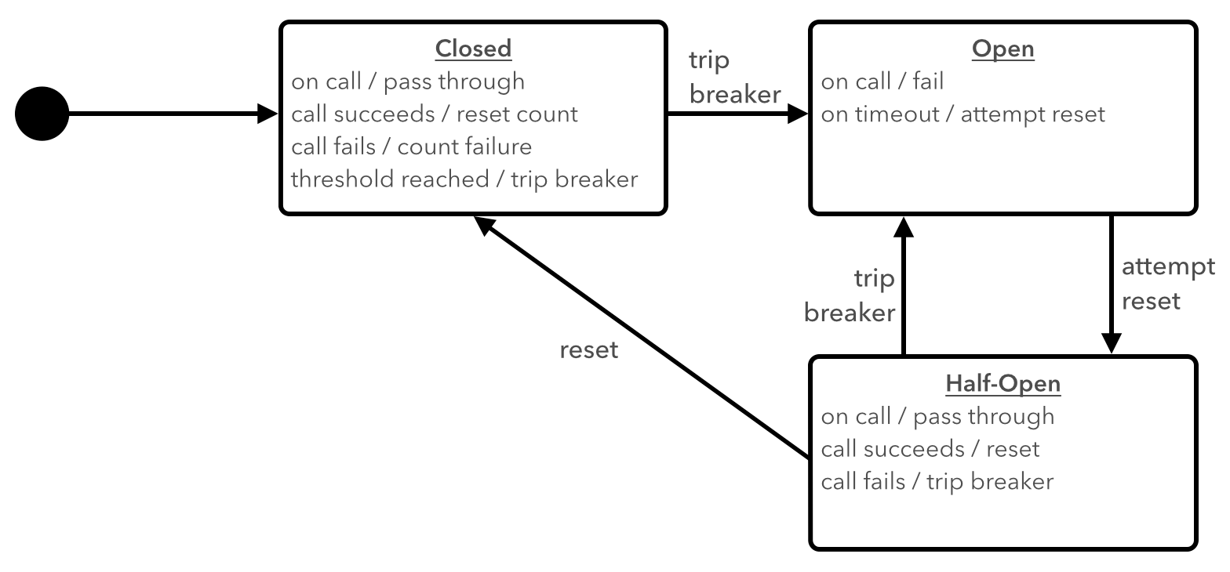

Slide 90
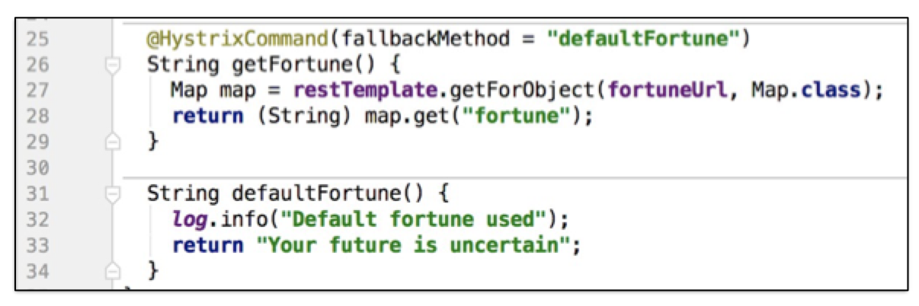
Annotating a Service Call
Add @EnableCircuitBreaker annotation to main application class
Annotate methods to add individual circuit breakers and fallbacks

Slide 91
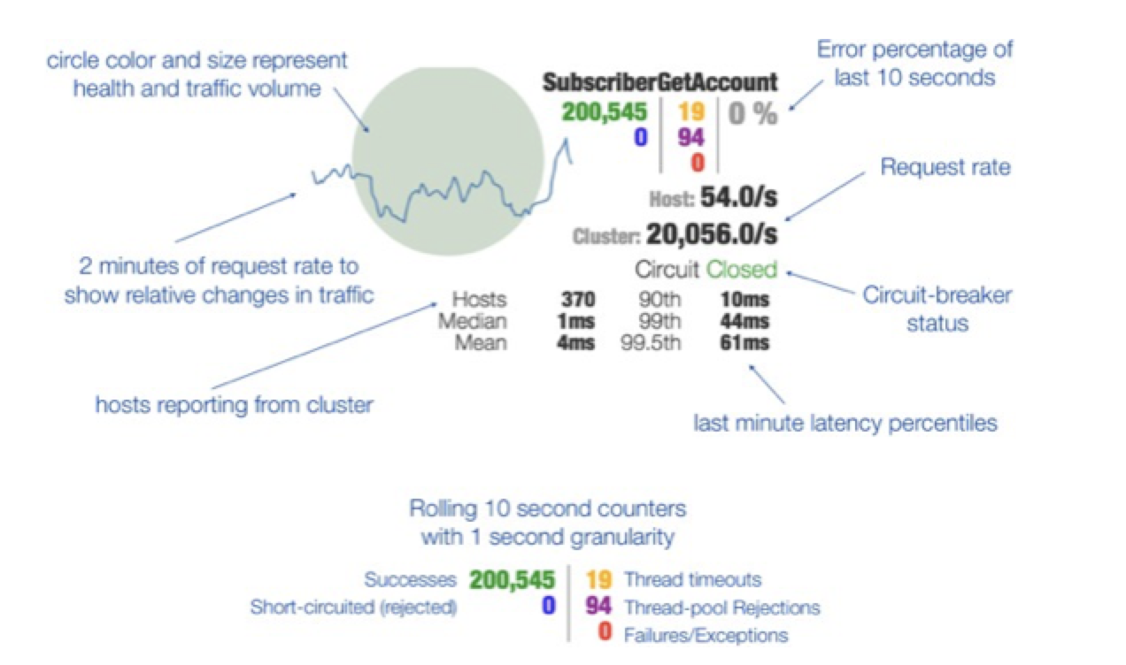
Circuit Breaker Monitoring

Slide 92
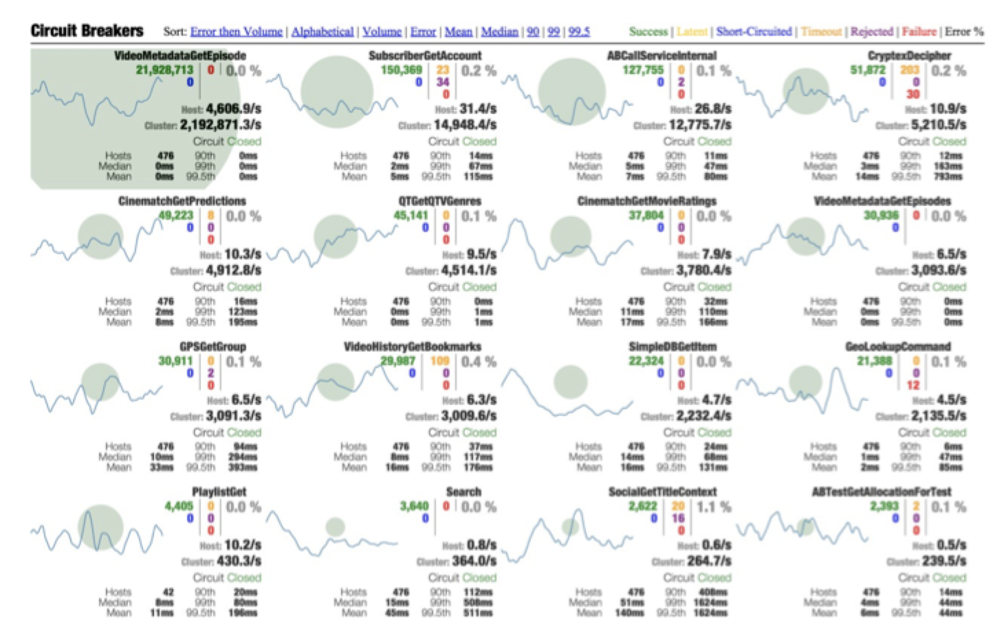
Example Dashboard

Slide 93
Service Discovery

Slide 94
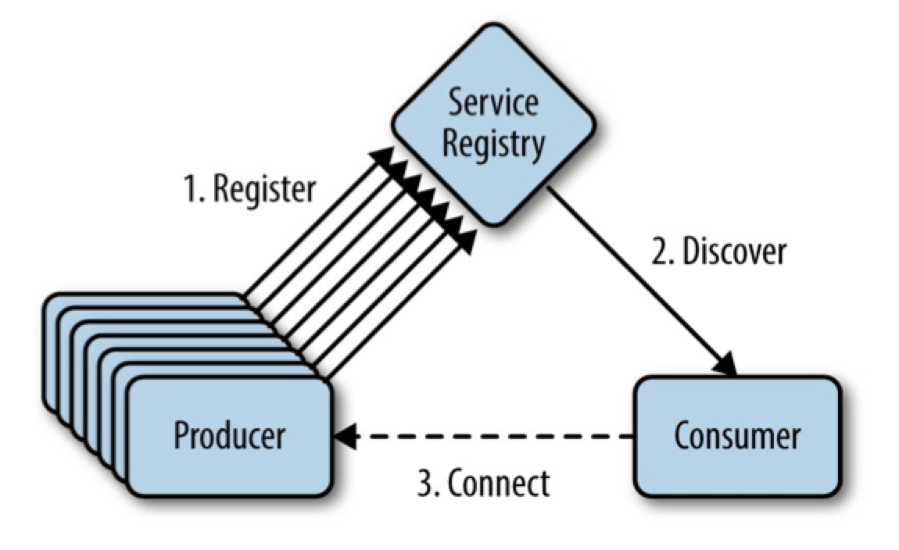
General Concept

Slide 95
Register
Service registers with eureka on startup
With Spring Cloud, the spring.application.name property is used as the registration key (or virtual hostname)

Slide 96
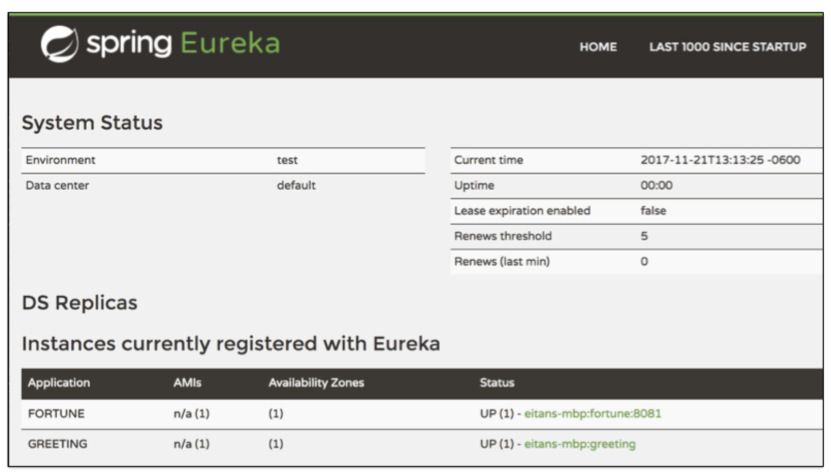
The Eureka Dashboard

Slide 97
Server-Side Configuration for SCS on Gaia
Create an instance of Service Registry in your space
Bind your app to the instance
via Apps Manager, the cf CLI, or your app manifest.yml

Slide 98
Client-Side Configuration for SCS on Gaia
Configure service with spring.application.name property
Annotate Spring Boot Application class with @EnableDiscoveryClient

Slide 99
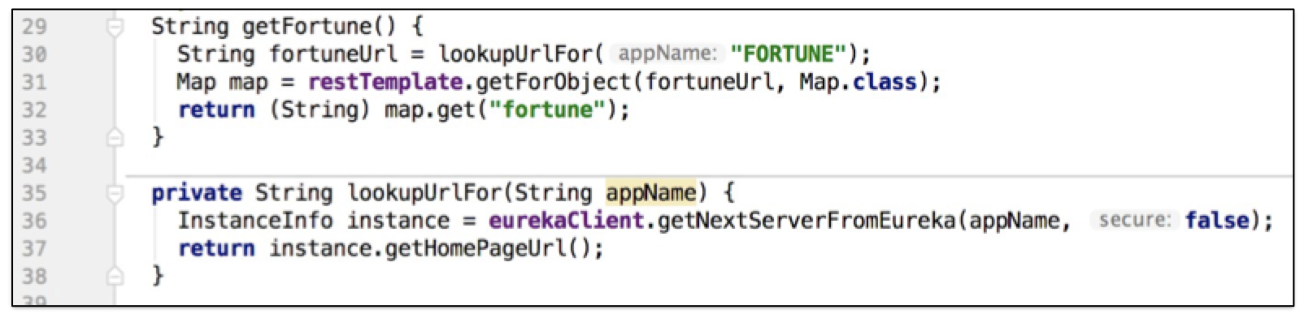
Eureka Lookup Example

Slide 100
Spring Cloud Config

Slide 101
Config Server - Main Concepts
Externalization of configuration (outside the application)
Centralization of configuration information for multiple services and environments
Configuration as a service
i.e. HTTP/REST endpoints for reading application configuration

Slide 102
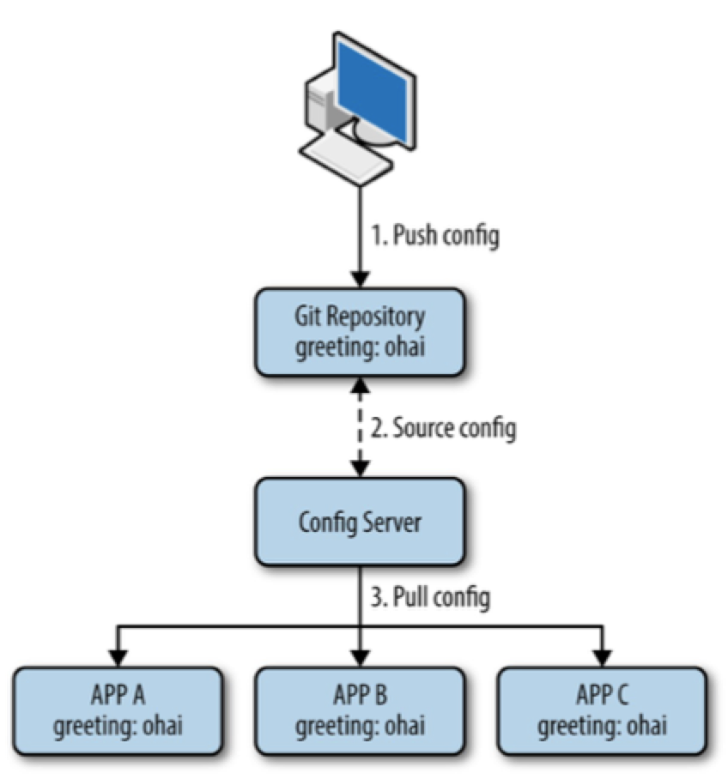

Slide 103
Design
Notion of a "backend" where configuration files are stored
Config server reads configurations from the back-end and exposes HTTP REST endpoints for applications to consume
Conventions: how files and REST endpoints are named make it easy to expose configuration for different applications in different environments

Slide 104
Backends
Supports multiple types of backends
Options include: Git, Subversion, HashiCorp Vault, File System, JDBC
Also supports a composite of backends

Slide 105
Conventions
An application’s spring.application.name is used to identify an application
The names of files stored in the backend
The paths for the endpoints exposed by the config server have a specific pattern

Slide 106
Backend File Naming
Default Pattern:
{application}-{profile}.[properties|yml]
Example:
spring.application.name: greeting spring.profiles.active: qa
Configuration stored in a file: greeting-qa.yml (or greeting-qa.properties)
NOTE: The pattern can be customized via a configuration property named searchPaths

Slide 107
Server-Side Configuration for SCS on PCF
Create an instance of Config Server in your space
Configuration git backend to a public repository
{"git": { "uri": "http://example.com/config" } }
Bind your app to the instance
via Apps Manager, the cf CLI, or your app manifest.yml

Slide 108
Configuring Clients
Set spring.application.name in the config file
in bootstrap.yml, not application.yml

Slide 109
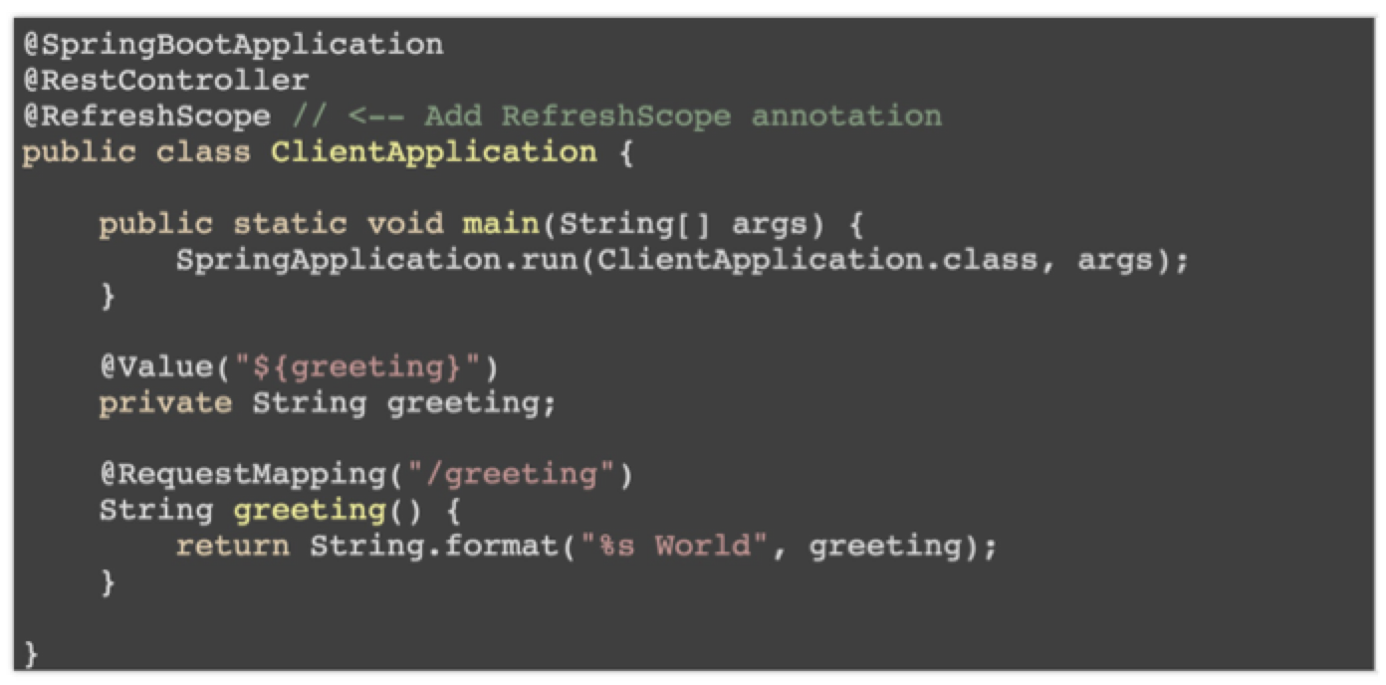
Example

Slide 110
Spring Cloud Bus
A solution to the problem of having to refresh multiple instances of multiple applications, without having to send each application instance a /refresh
Leverages a message bus, supports AMQP protocol (e.g. RabbitMQ), and Kafka
Exposes its own /bus/refresh endpoint, where receiving application instance broadcasts refresh message to all other instances

Slide 111
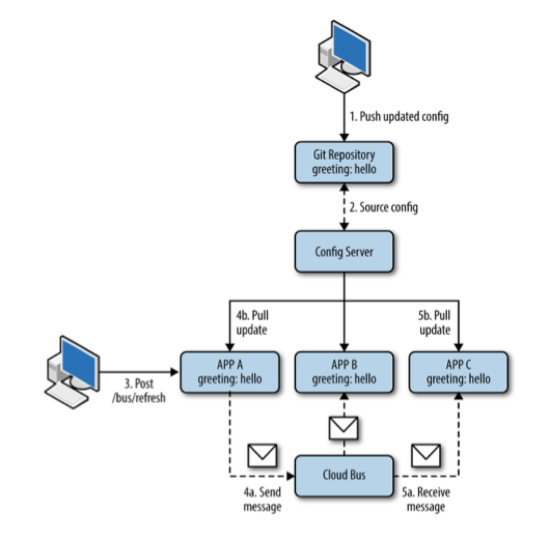
Config Server and Spring Cloud Bus

Slide 112
Benefits of Config Server
All configuration is available in one place (one place to review and modify configuration)
Separation of application development lifecycle from configuration lifecycle
Ability to re-configure aspects of a running application without downtime (e.g. log level, feature toggles)
Supports encryption of sensitive configuration properties using a number of mechanisms (symmetric encryption, asymmetric key pair)
Choice of git backend provides complete configuration history, auditability (who made what configuration change, and when)

Slide 113
Recap
Circuit Breakers with Netflix Hystrix
Protect your apps against cascading effects of failure and latency
Service Discovery with Netflix Eureka
Enable your apps to dynamically locate each other
Spring Cloud Config
Externalize and centralize configuration, providing it to your apps as a service

Slide 114






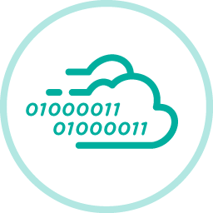
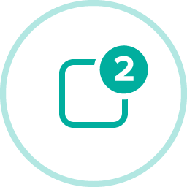
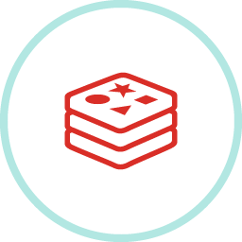


Spring Cloud Services, Connectors, Integrations
Circuit Breaker
Config Server
API Gateway
RabbitMQ
Service Registry
MySQL
Pivotal Cloud Cache
Pivotal GemFire
Pivotal Push Notifications
Redis
Riak
Session State Caching
Notes:
The talk track on this is not only about Spring Cloud integrations, but other integrations with Pivotal software, such as PCF, PCC, etc.

Slide 115
Questions?
SESSION FIVE
Notes:
Agenda:
Monolith
Domain Driven Design
Cloud Native

Slide 116
Service Discovery Pattern
1. Register
2. Discover
Consumer
3. Connect
Notes:
Push the config.
Git updates.
Spring Config Server reads the new config.
Dev/Integration sends the POST to update the configs.
First application to receive the POST sends an update to Rabbit.
Rabbit publishes the change to the other applications subscribed.
Everyone is updated and happy.

Slide 117
Client Services
@EnableDiscoveryClient
@EnableZuulProxy // <- for Zuul Reverse Proxy
@EnableConfigServer // <- for built-in Config Server
@SpringBootApplication
public class QuotesService {
public static void main(String[] args) {
SpringApplication.run(QuotesService.class, args);
}
}
Notes:
The server is easily embeddable in a Spring Boot application using the @EnableConfigServer annotation.
Application configuration data is stored in a backend
Git, Subversion and File System backends are supported
Git is the default backend. It's great for auditing changes and managing upgrades
Setting the git backend is done via the spring.cloud.config.server.git.uriconfiguration property

Slide 118
Questions?
SESSION SEVEN
Notes:
Agenda:
Monolith
Domain Driven Design
Cloud Native

Slide 119
Learn more!
http://pivotal.io/microservices
https://www.microsoft.com/net/learn/architecture
http://spring.io/
http://start.spring.io/
http://steeltoe.io
https://github.com/steeltoeoss
Notes:
resources

